Slide 1
Game Formulation
Notes:
videos:
-
authors: BBC
url: https://www.youtube.com/watch?v=KF6sLCeBj0s
title: Deep Blue vs Kasparov&colon; How a computer beat best chess player in the world
length: 4 minutes
-
url: https://www.youtube.com/watch?v=HT-UZkiOLv8
title: Lee Sedol vs AlphaGo Move 37 reactions and analysis
length: 4 minutes
-
authors: Pieter Abbeel
url: https://www.youtube.com/watch?v=jvpWtwVSvjA
title: Step-by-step Example&colon; Alpha-Beta
length: 14 minutes

Slide 2
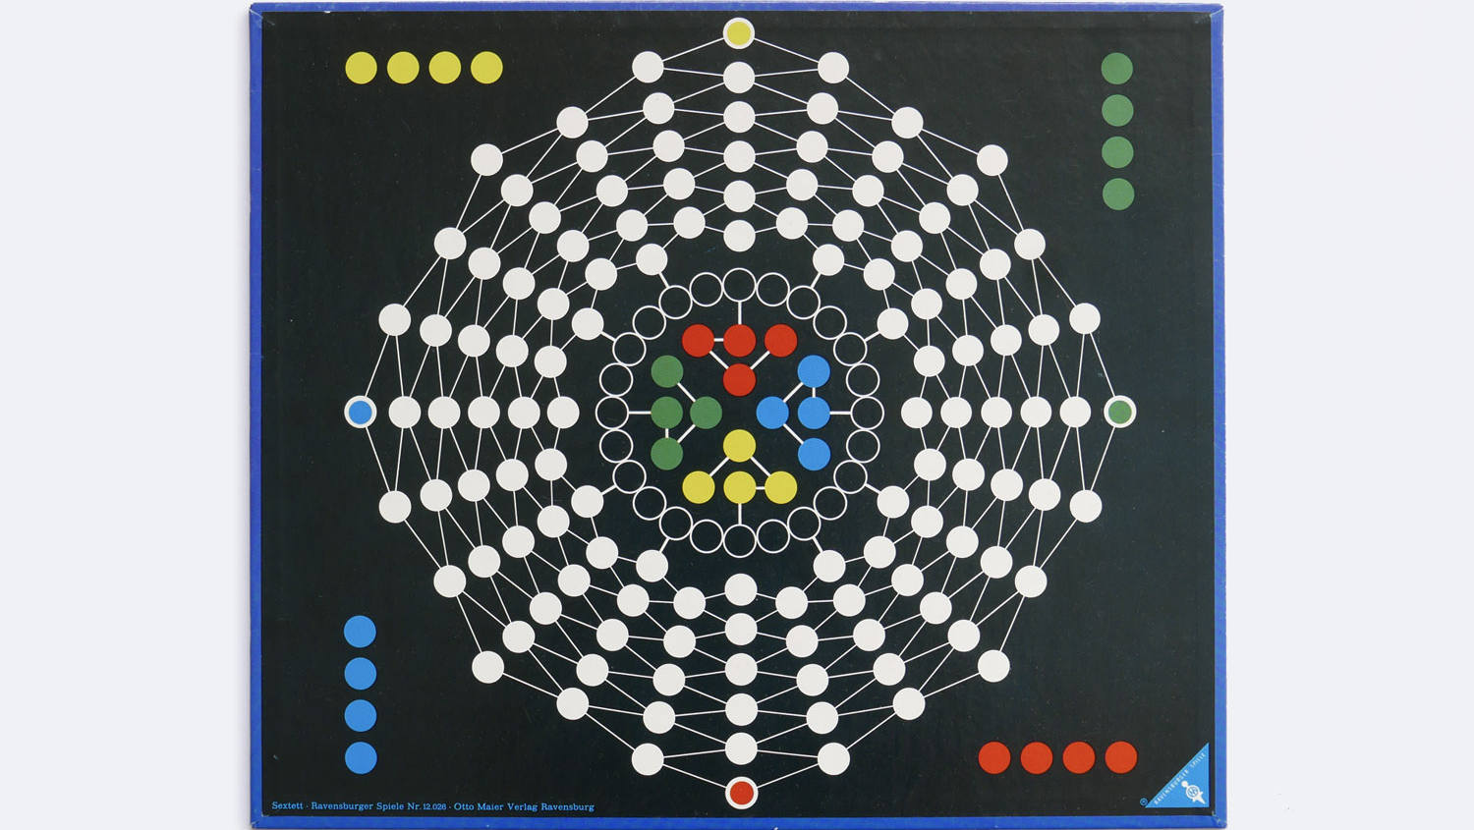

Slide 3

Games: Outline of Unit
Part 1: Games as Search
Motivation
Game-playing AI successes
Game Trees
Evaluation Functions
Part II: Adversarial Search
The Minimax Rule
Alpha-Beta Pruning
Notes:
.

Slide 4

May 11, 1997
Notes:
.

Slide 5
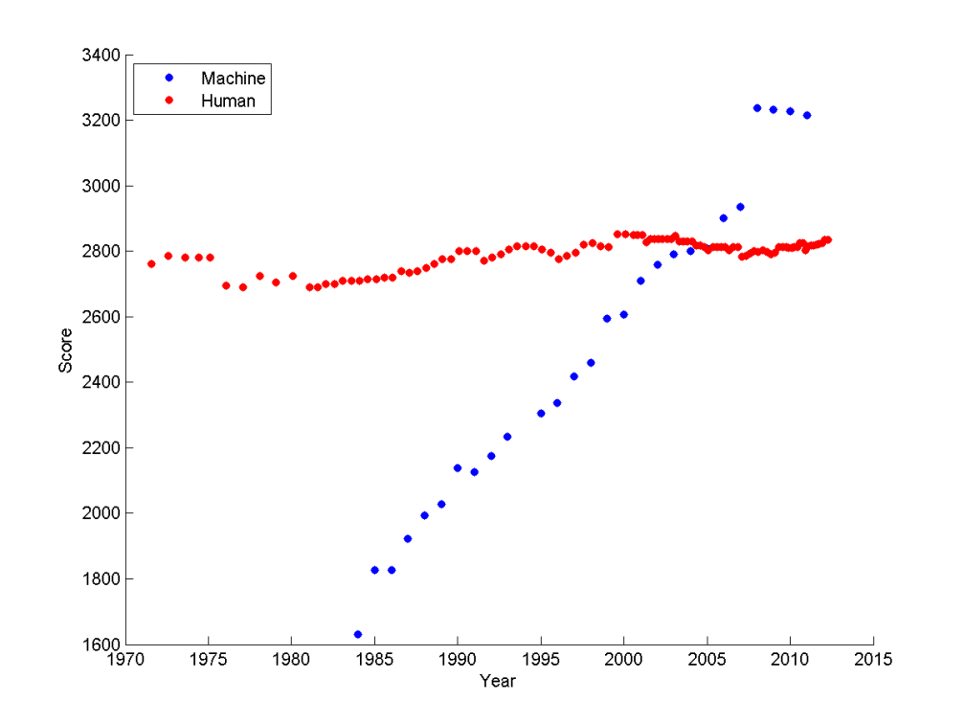
Ratings of human and computer chess champions
https://srconstantin.wordpress.com/2017/01/28/performance-trends-in-ai/
Notes:
Y axis shows Elo scores. The Elo^{[a]} rating system is a method for calculating the relative skill levels of players games like chess.

Slide 6

May 11, 1997
Callout box
Bulleted list
Bulleted list level 2
Content font: Open Sans Size 20
Heading font: Open Sans Bold 34
Code block: Roboto Mono Size 20 with Gray background
Colors: Purple Yellow Cyan (accent) Light gray (background)
Callout box
Notes:
The board of Go is 19×19=361 intersections while Chess has 8×8=64 squares. The possible number of first moves in chess is 20 white × 20 black = 400 moves. In Go, it is 361×360=129960. Due to symmetry though, it is reduced to 32490, but it is still way more than chess. The opening of chess is fixed by custom and strong first moves are fixed at around 64 moves. The board of Go begins empty and the players put their stones anywhere that they wish to uniquely structure the board in every game. Strong starting first moves are fixed at 992.
The estimated number of possible board configuration is 10¹²º in chess which is astronomical but Go has around 10¹⁷⁴. It may not seem a lot more than chess's 10¹²º but it is actually 1 million trillion trillion trillion trillion more configurations than chess! That is a lot more.
The estimated number of atoms in the universe is about 10^80.
Chess is more like emphasising in short-term profits while Go is more like long-term planning. Chess is more like a single battle while Go is like a multi-front war.
https://www.quora.com/How-does-the-complexity-of-Go-compare-with-Chess

Slide 7
The Simplest Game Environment
Multiagent
Static: No change while an agent is deliberating.
Discrete: A finite set of percepts and actions.
Fully observable: An agent's sensors give it the complete state of the environment.
Strategic: The next state is determined by the current state and the action executed by the agent and the actions of one other agent.
Notes:
.

Slide 8
Key properties of our games
Two players alternate moves
Zero-sum: one player’s loss is another’s gain
Clear set of legal moves
Well-defined outcomes (e.g. win, lose, draw)
Examples:
Chess, Checkers, Go,
Mancala, Tic-Tac-Toe, Othello …
Notes:
.

Slide 9
More complicated games
Most card games (e.g. Hearts, Bridge, etc.) and Scrabble
Stochastic, not deterministic
Not fully observable: lacking in perfect information
Real-time strategy games
Continuous rather than discrete
No pause between actions, don’t take turns
Cooperative games
Notes:
.

Slide 10

Pac-Man
https://youtu.be/-CbyAk3Sn9I
Notes:
https://www.youtube.com/watch?v=-CbyAk3Sn9I

Slide 11
Formalizing the Game setup
Two players: MAX and MIN; MAX moves first.
MAX and MIN take turns until the game is over.
Winner gets award, loser gets penalty.
Games as search:
Initial state: e.g. board configuration of chess
Successor function: list of (move,state) pairs specifying legal moves.
Terminal test: Is the game finished?
Utility function: Gives numerical value of terminal states. e.g. win (+∞), lose (-∞) and draw (0)
MAX uses search tree to determine next move.
Notes:
.

Slide 12
How to Play a Game by Searching
General Scheme
Consider all legal successors to the current state (‘board position’)
Evaluate each successor board position
Pick the move which leads to the best board position.
After your opponent moves, repeat.
Design issues
Representing the ‘board’
Representing legal next boards
Evaluating positions
Looking ahead
Notes:
.

Slide 13

Hexapawn: A very simple Game
Hexapawn is played on a 3x3 chessboard
Only standard pawn moves:
A pawn moves forward one square onto an empty square
A pawn “captures” an opponent pawn by moving diagonally forward one square, if that square contains an opposing pawn. The opposing pawn is removed from the board.
Notes:
Let's take an example of a toy game. This is a toy game invented in the 1960s to teach people about programming before computers even became widespread. This game is called Hexapawn. It's a three by three chessboard with six pawn pieces. This is a tiny little game of chess that removes a lot of the complication that you have by virtue of the chess pieces each having a different move. If you're not a chess player, a pawn has two styles of move. Either it can move forward one square, just up or down in this game representation and then it can capture by moving along the diagonal to grab a piece that sits in an adjacent square that's diagonal from it. That's called a capture. You capture an opponent's pawn by moving diagonally forward one square, and then you take that pawn off the board. You remove the opponents piece off the board.

Slide 14
Hexapawn: A very simple Game
Hexapawn is played on a 3x3 chessboard
Player P₁ wins the game against P₂ when:
One of P₁’s pawns reaches the far side of the board, or
P₂ cannot move because no legal move is possible.
P₂ has no pawns left.
(Invented by Martin Gardner in 1962, with learning “program” using match boxes.)
Notes:
The rules of Hexapawn are basically, you play this game and the first player wins against the second player when one of the first players pawn reaches all to the way to the other side of the board. Or the second player can't move at all because there's no legal move that's possible. Or if the first player has captured all of the second player is pawns. We can start by seeing what the possible moves are in our search tree.

Slide 15
Hexapawn: Three Possible First Moves
⬤ | ⬤ | ⬤​
​ | ​ | ​
⬤​ | ⬤ | ⬤​
White moves​
⬤ | ⬤​ | ⬤​
⬤​ | ​ | ​
 | ⬤​ | ⬤​
⬤​ | ⬤​ | ⬤​
​ | ⬤​ | ​
⬤ | ​ | ⬤​
⬤​ | ⬤ | ⬤
​ | ​ | ⬤​
⬤​ | ⬤​ | ​
Notes:
Here we have a search tree or a game tree. Where we're going to represent the state in our search tree as the layout of the board. If we're opening with white being able to move first, then there's only three possible successors. Here's our initial board, where we've got the black and the white pieces and their starting positions. Either the leftmost white piece can move, or the middle white piece can move, or the right one can move. That's going to be the idea of starting to represent the search space as this game tree that shows the configuration of the board. The nodes in our tree are going to be represented by board positions, and edges in our tree represent the legal moves to move from one board configuration or position into another. The root node is just the initial configuration. That's where we're going to have to start making our decisions. The complete game tree is the search tree that follows from applying every sequence of moves all the way to all possible terminals tickets. This is going to be the thing that makes game-playing challenging. Like we said before, there's like an astronomical number of possible board configurations for chess can go. You could even have situations where the game tree is infinite because the game allows you to repeatedly go through the same position. You can expand this notion of game tree out, not just for the opening move, but for the next move. Here's an example of Hexapawn for two moves. The opening move has three moves for white. Then the next layer of the tree is going to be a move for black. This is called a ply. One ply is going to be one layer of the tree where that's going to be the one player. Then the next ply of the tree is going to be the other player in response to the leftmost one here, where white moved its left pawn. Black can either capture that by moving its middle pawn, or it can move its middle pawn forward, or it can move its right pawn forward. It can't move its black pawn forward because that position is blocked.

Slide 16
Game Trees
Represent the game problem space by a tree:
Nodes represent ‘board positions’; edges represent legal moves.
Root node is the first position in which a decision must be made.
Notes:
The complete game tree is the search tree that follows every sequence of moves all the way to the terminal state. The estimated number of possible board configuration is 10¹²º in chess which is astronomical but Go has around 10¹⁷⁴ The game tree may be infinite if the game allows infinitely repeating position or if the state space is unbounded.

Slide 17
Hexapawn: Simplified Game Tree for 2 Moves
⬤ | ⬤ | ⬤​
​ | ​ | ​
⬤​ | ⬤ | ⬤​
White to move​
⬤ | ⬤​ | ⬤​
⬤​ | ​ | ​
 | ⬤​ | ⬤​
⬤​ | ⬤​ | ⬤​
​ | ⬤​ | ​
⬤ | ​ | ⬤​
⬤​ | ⬤ | ⬤
​ | ​ | ⬤​
⬤​ | ⬤​ | ​
Black to move​
⬤
⬤
⬤
⬤ | ​ | ⬤​
⬤​ | ​ | ​
 | ⬤​ | ⬤​
⬤ |  | ⬤​
⬤​ | ⬤​ | ​
 | ⬤​ | ⬤​
⬤ | ⬤​ | ​
⬤​ | ​ | ​⬤
 | ⬤​ | ⬤​
​ | ⬤​ | ⬤​
​⬤ | ⬤​ | ​
⬤ | ​ | ⬤​
 | ⬤​ | ⬤​
​ | ⬤ | ​
⬤ | ​ | ⬤​
⬤ | ⬤​ | ​
​ | ⬤ | ​
⬤ | ​ | ⬤​
⬤​ | ⬤ | ⬤
​ | ⬤​ | ⬤​
⬤​ | ⬤​ | ​
White ​ to move​
Notes:
.

Slide 18

Adversarial Search
Notes:
.

Slide 19

Battle of Wits
https://www.youtube.com/watch?v=rMz7JBRbmNo
Notes:
Turn volume up!
Good stopping points:
1:27 – “Truly you have a dizzying intellect”
3:15 – “Death of the sicilian”

Slide 20
Adversarial Search
Notes:
videos:
-
authors: BBC
url: https://www.youtube.com/watch?v=KF6sLCeBj0s
title: Deep Blue vs Kasparov&colon; How a computer beat best chess player in the world
length: 4 minutes
-
url: https://www.youtube.com/watch?v=HT-UZkiOLv8
title: Lee Sedol vs AlphaGo Move 37 reactions and analysis
length: 4 minutes
-
authors: Pieter Abbeel
url: https://www.youtube.com/watch?v=jvpWtwVSvjA
title: Step-by-step Example&colon; Alpha-Beta
length: 14 minutes

Slide 21
Games: Outline of Unit
Part 1: Games as Search
Motivation
Game-playing AI successes
Game Trees
Evaluation Functions
Part II: Adversarial Search
The Minimax Rule
Alpha-Beta Pruning
CIS 421/521 | 2
Notes:
.

Slide 22
MAX & MIN Nodes : An egocentric view
Two players: MAX, MAX’s opponent MIN
All play is computed from MAX’s vantage point.
When MAX moves, MAX attempts to MAXimize MAX’s outcome.
When MAX’s opponent moves, they attempt to MINimize MAX’s outcome.
WE TYPICALLY ASSUME MAX MOVES FIRST:
Label the root (level 0) MAX
Alternate MAX/MIN labels at each successive tree level (ply).
Even levels represent turns for MAX
Odd levels represent turns for MIN
Notes:
.

Slide 23
Game Trees
Represent the game problem space by a tree:
Nodes represent ‘board positions’; edges represent legal moves.
Root node is the first position in which a decision must be made.
Evaluation function f assigns real-number scores to `board positions’ without reference to path
Terminal nodes represent ways the game could end, labeled with the desirability of that ending (e.g. win/lose/draw or a numerical score)
Notes:
.

Slide 24
Evaluation functions: f(n)
Evaluates how good a ‘board position’ is
Based on static features of that board alone
Zero-sum assumption lets us use one function to describe goodness for both players.
f(n)>0 if MAX is winning in position n
f(n)=0 if position n is tied
f(n)<0 if MIN is winning in position n
Build using expert knowledge,
Tic-tac-toe: f(n)=(# of 3 lengths open for MAX)- (# open for MIN)
CIS 421/521 | 21
Notes:
.

Slide 25
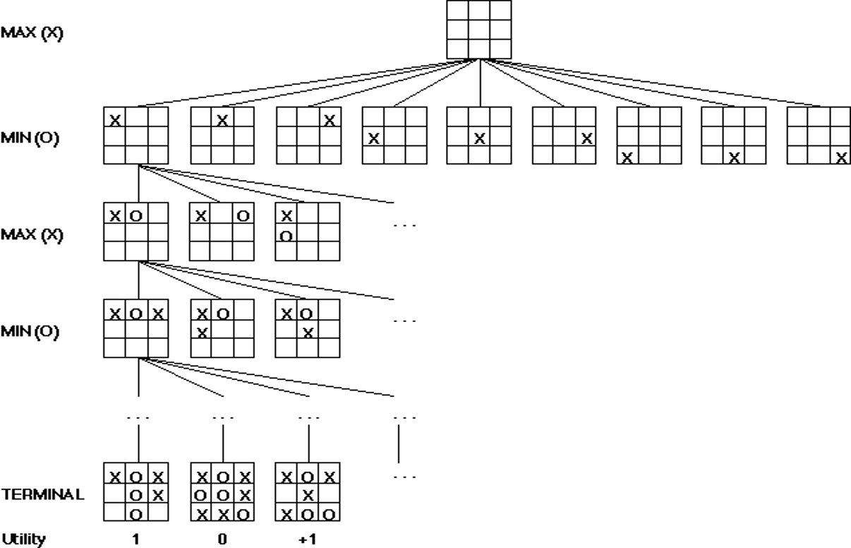
A Partial Game Tree for Tic-Tac-Toe
f(n)=# of potential three-lines for X –
# of potential three-line for O
f(n)=0 if n is a terminal tie
f(n)=+ ∞ if n is a terminal win
f(n)=- ∞ if n is a terminal loss
f(n)=8-5=3​
f(n)=2​
f(n)=3​
f(n)=2​
f(n)=4​
f(n)=2​
f(n)=3​
f(n)=2​
f(n)=3​
f(n)=6-5=1​
f(n)=0​
f(n)=1​
f(n)=6-3=3​
f(n)=6-4=2​
f(n)=6-2=4​
f(n)=# of potential three-lines for X –​
# of potential three-line for O ​
​
f(n)=0 if n is a terminal tie​
f(n)=+ ∞ if n is a terminal win​
f(n)=- ∞ if n is a terminal loss​
-∞​
​
0​
+ ∞​
Notes:
.

Slide 26
Chess Evaluation Functions
Claude Shannon argued for a chess evaluation function in a 1950 paper
Alan Turing defined function in 1948: f(n)=(sum of A’s piece values) - (sum of B’s piece values)
More complex: weighted sum of positional features:
Σ w_{i} feature_{i}(n)
Deep Blue had >8000 features
Pawn​ | 1.0​
Knight​ | 3.0​
Bishop​ | 3.25​
Rook​ | 5.0​
Queen​ | 9.0​
Pieces values for a simple Turing-style evaluation function often taught ​ to novice chess players​
Positive: rooks on open files, knights in​
closed positions, control of the center, ​
developed pieces​
​
Negative: doubled pawns, wrong-colored ​
bishops in closed positions, isolated pawns, pinned pieces​
Examples of more complex features​
CIS 421/521 | 23
Notes:
.

Slide 27
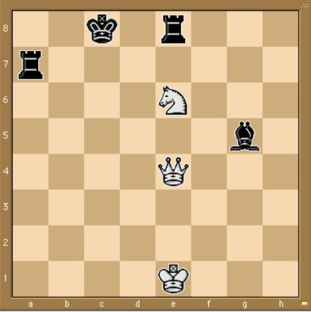
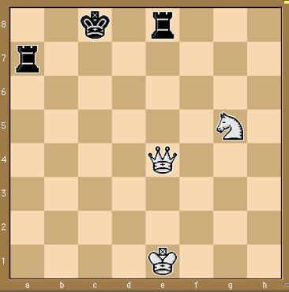
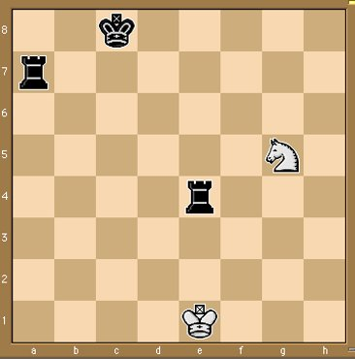
Some Chess Positions and their Evaluations
White to move​
f(n)=(9+3)-(5+5+3.25)​
=-1.25​
… Nxg5??​
f(n)=(9+3)-(5+5)​
=2​
Uh-oh: Rxg4+​
f(n)=(3)-(5+5)​
=-7​
And black may ​
force checkmate​
So, considering our opponent’s possible​
responses would be wise.​
Notes:
.

Slide 28
Minimax and Alpha-Beta Pruning
Notes:
-
url: https://www.youtube.com/watch?v=HT-UZkiOLv8
title: Lee Sedol vs AlphaGo Move 37 reactions and analysis
length: 4 minutes

Slide 29
The Minimax Rule: “Don’t play hope chess”
Idea: Make the best move for MAX assuming that MIN always replies with the best move for MIN
Easily computed by a recursive process
The backed-up value of each node in the tree is determined by the values of its children:
For a MAX node, the backed-up value is the maximum of the values of its children (i.e. the best for MAX)
For a MIN node, the backed-up value is the minimum of the values of its children (i.e. the best for MIN)
CIS 421/521 | 26
Notes:
"Don't play hope chess" is an expression often used in the chess community to advise against making moves based solely on the hope or assumption that an opponent will respond a certain way, especially if that hoped-for response is a blunder or oversight on their part.
In other words, when a player is engaging in "hope chess," they might think, "I'll move here, and hopefully, my opponent won't see the threat and I'll win a piece or deliver checkmate." This approach is not sound because it's based on the opponent making mistakes rather than on the player's own good moves or strategy.
Instead of playing "hope chess," players are encouraged to:
1. **Think ahead**: Consider both your moves and possible responses from your opponent.
2. **Evaluate the position**: Understand the implications of each move and the resulting positions.
3. **Have a plan**: Rather than hoping for mistakes, base your decisions on a strategic or tactical plan.
4. **Be cautious**: Always check for threats from the opponent before finalizing a move.
Playing "hope chess" is particularly common among beginners. As players gain experience and improve their skills, they tend to rely less on their opponents' mistakes and more on their own strategy and tactics.

Slide 30
The Minimax Procedure
Until game is over:
Start with the current position as a MAX node.
Expand the game tree a fixed number of ply.
Apply the evaluation function to the leaf positions.
Calculate back-up values bottom-up.
Pick the move assigned to MAX at the root
Wait for MIN to respond
Notes:
.

Slide 31
Adversarial Search (Minimax)
Minimax search:
A state-space search tree
Players alternate turns
Compute each node’s minimax value: the best achievable utility against a rational (optimal) adversary
Minimax values: computed recursively
5
max
2
5
min
8
2
5
6
Terminal values: part of the game
Notes:
Slide from Dan Klien

Slide 32
Minimax Implementation
def max-value(state):
if the state is a terminal state:
return the state’s utility
initialize v = -∞
for each successor of state:
v = max(v, min-value(successor))
return v
def min-value(state):
if the state is a terminal state:
return the state’s utility
initialize v = +∞
for each successor of state:
v = min(v, max-value(successor))
return v
CIS 521 | 3
Notes:
Slide from Dan Klien

Slide 33
What if MIN does not play optimally?
Definition of optimal play for MAX assumes MIN plays optimally:
Maximizes worst-case outcome for MAX.
(Classic game theoretic strategy)
But if MIN does not play optimally, MAX will do even better.
This theorem is not hard to prove
Notes:
.

Slide 34
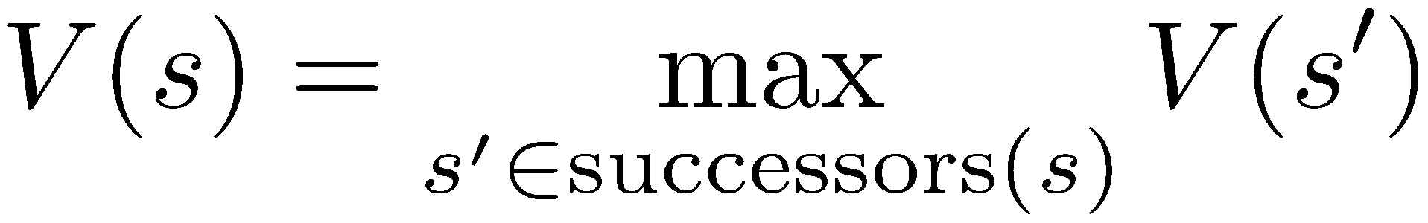
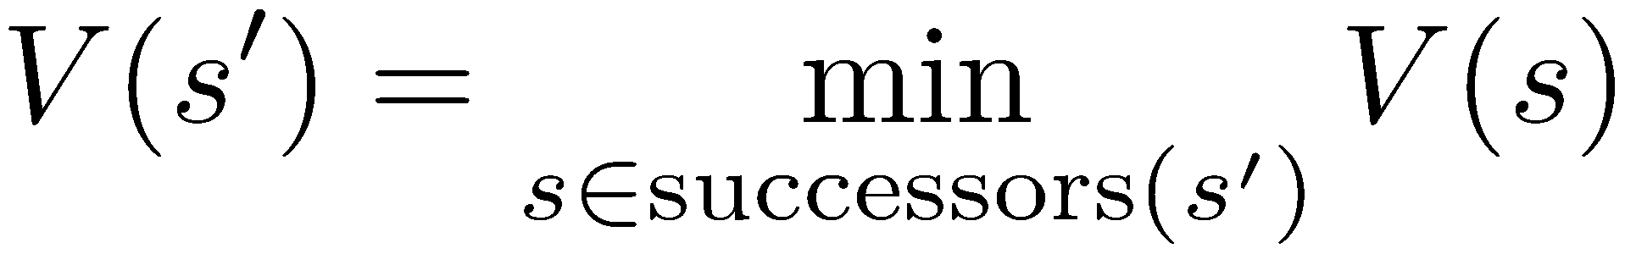
Minimax Example
-∞
def max-value(state):
if the state is a terminal state:
return the state’s utility
initialize v = -∞
for each successor of state:
v = max(v, min-value(successor))
return v
def min-value(state):
if the state is a terminal state:
return the state’s utility
initialize v = +∞
for each successor of state:
v = min(v, max-value(successor))
return v
Notes:
.

Slide 35
Minimax Example
-∞
def max-value(state):
if the state is a terminal state:
return the state’s utility
initialize v = -∞
for each successor of state:
v = max(v, min-value(successor))
return v
def min-value(state):
if the state is a terminal state:
return the state’s utility
initialize v = +∞
for each successor of state:
v = min(v, max-value(successor))
return v
Notes:
.

Slide 36
Minimax Example
-∞
def max-value(state):
if the state is a terminal state:
return the state’s utility
initialize v = -∞
for each successor of state:
v = max(v, min-value(successor))
return v
def min-value(state):
if the state is a terminal state:
return the state’s utility
initialize v = +∞
for each successor of state:
v = min(v, max-value(successor))
return v
Notes:
.

Slide 37
Minimax Example
-∞
+∞
def max-value(state):
if the state is a terminal state:
return the state’s utility
initialize v = -∞
for each successor of state:
v = max(v, min-value(successor))
return v
def min-value(state):
if the state is a terminal state:
return the state’s utility
initialize v = +∞
for each successor of state:
v = min(v, max-value(successor))
return v
Notes:
.

Slide 38
Minimax Example
-∞
+∞
def max-value(state):
if the state is a terminal state:
return the state’s utility
initialize v = -∞
for each successor of state:
v = max(v, min-value(successor))
return v
def min-value(state):
if the state is a terminal state:
return the state’s utility
initialize v = +∞
for each successor of state:
v = min(v, max-value(successor))
return v
Notes:
.

Slide 39
Minimax Example
-∞
+∞
def max-value(state):
if the state is a terminal state:
return the state’s utility
initialize v = -∞
for each successor of state:
v = max(v, min-value(successor))
return v
def min-value(state):
if the state is a terminal state:
return the state’s utility
initialize v = +∞
for each successor of state:
v = min(v, max-value(successor))
return v
Notes:
.

Slide 40
Minimax Example
-∞
+∞
def max-value(state):
if the state is a terminal state:
return the state’s utility
initialize v = -∞
for each successor of state:
v = max(v, min-value(successor))
return v
def min-value(state):
if the state is a terminal state:
return the state’s utility
initialize v = +∞
for each successor of state:
v = min(v, max-value(successor))
return v
Notes:
.

Slide 41
Minimax Example
-∞
3
3
def max-value(state):
if the state is a terminal state:
return the state’s utility
initialize v = -∞
for each successor of state:
v = max(v, min-value(successor))
return v
def min-value(state):
if the state is a terminal state:
return the state’s utility
initialize v = +∞
for each successor of state:
v = min(v, max-value(successor))
return v
Notes:
.

Slide 42
Minimax Example
-∞
3
3
8
def max-value(state):
if the state is a terminal state:
return the state’s utility
initialize v = -∞
for each successor of state:
v = max(v, min-value(successor))
return v
def min-value(state):
if the state is a terminal state:
return the state’s utility
initialize v = +∞
for each successor of state:
v = min(v, max-value(successor))
return v
Notes:
.

Slide 43
Minimax Example
-∞
3
3
8
def max-value(state):
if the state is a terminal state:
return the state’s utility
initialize v = -∞
for each successor of state:
v = max(v, min-value(successor))
return v
def min-value(state):
if the state is a terminal state:
return the state’s utility
initialize v = +∞
for each successor of state:
v = min(v, max-value(successor))
return v
Notes:
.

Slide 44
Minimax Example
-∞
3
3
8
12
def max-value(state):
if the state is a terminal state:
return the state’s utility
initialize v = -∞
for each successor of state:
v = max(v, min-value(successor))
return v
def min-value(state):
if the state is a terminal state:
return the state’s utility
initialize v = +∞
for each successor of state:
v = min(v, max-value(successor))
return v
Notes:
.

Slide 45
Minimax Example
-∞
3
3
8
12
def max-value(state):
if the state is a terminal state:
return the state’s utility
initialize v = -∞
for each successor of state:
v = max(v, min-value(successor))
return v
def min-value(state):
if the state is a terminal state:
return the state’s utility
initialize v = +∞
for each successor of state:
v = min(v, max-value(successor))
return v
Notes:
.

Slide 46
Minimax Example
-∞
3
3
8
12
def max-value(state):
if the state is a terminal state:
return the state’s utility
initialize v = -∞
for each successor of state:
v = max(v, min-value(successor))
return v
def min-value(state):
if the state is a terminal state:
return the state’s utility
initialize v = +∞
for each successor of state:
v = min(v, max-value(successor))
return v
Notes:
.

Slide 47
Minimax Example
3
3
3
8
12
def max-value(state):
if the state is a terminal state:
return the state’s utility
initialize v = -∞
for each successor of state:
v = max(v, min-value(successor))
return v
def min-value(state):
if the state is a terminal state:
return the state’s utility
initialize v = +∞
for each successor of state:
v = min(v, max-value(successor))
return v
Notes:
.

Slide 48
Minimax Example
3
3
3
8
12
def max-value(state):
if the state is a terminal state:
return the state’s utility
initialize v = -∞
for each successor of state:
v = max(v, min-value(successor))
return v
def min-value(state):
if the state is a terminal state:
return the state’s utility
initialize v = +∞
for each successor of state:
v = min(v, max-value(successor))
return v
Notes:
.

Slide 49
Minimax Example
3
3
+∞
3
8
12
def max-value(state):
if the state is a terminal state:
return the state’s utility
initialize v = -∞
for each successor of state:
v = max(v, min-value(successor))
return v
def min-value(state):
if the state is a terminal state:
return the state’s utility
initialize v = +∞
for each successor of state:
v = min(v, max-value(successor))
return v
Notes:
.

Slide 50
Minimax Example
3
3
+∞
3
8
12
def max-value(state):
if the state is a terminal state:
return the state’s utility
initialize v = -∞
for each successor of state:
v = max(v, min-value(successor))
return v
def min-value(state):
if the state is a terminal state:
return the state’s utility
initialize v = +∞
for each successor of state:
v = min(v, max-value(successor))
return v
Notes:
.

Slide 51
Minimax Example
3
3
+∞
3
8
12
def max-value(state):
if the state is a terminal state:
return the state’s utility
initialize v = -∞
for each successor of state:
v = max(v, min-value(successor))
return v
def min-value(state):
if the state is a terminal state:
return the state’s utility
initialize v = +∞
for each successor of state:
v = min(v, max-value(successor))
return v
Notes:
.

Slide 52
Minimax Example
3
3
+∞
3
8
12
2
def max-value(state):
if the state is a terminal state:
return the state’s utility
initialize v = -∞
for each successor of state:
v = max(v, min-value(successor))
return v
def min-value(state):
if the state is a terminal state:
return the state’s utility
initialize v = +∞
for each successor of state:
v = min(v, max-value(successor))
return v
Notes:
.

Slide 53
Minimax Example
3
3
2
3
8
12
2
def max-value(state):
if the state is a terminal state:
return the state’s utility
initialize v = -∞
for each successor of state:
v = max(v, min-value(successor))
return v
def min-value(state):
if the state is a terminal state:
return the state’s utility
initialize v = +∞
for each successor of state:
v = min(v, max-value(successor))
return v
Notes:
.

Slide 54
Minimax Example
3
3
2
3
8
12
2
4
def max-value(state):
if the state is a terminal state:
return the state’s utility
initialize v = -∞
for each successor of state:
v = max(v, min-value(successor))
return v
def min-value(state):
if the state is a terminal state:
return the state’s utility
initialize v = +∞
for each successor of state:
v = min(v, max-value(successor))
return v
Notes:
.

Slide 55
Minimax Example
3
3
2
3
8
12
2
4
def max-value(state):
if the state is a terminal state:
return the state’s utility
initialize v = -∞
for each successor of state:
v = max(v, min-value(successor))
return v
def min-value(state):
if the state is a terminal state:
return the state’s utility
initialize v = +∞
for each successor of state:
v = min(v, max-value(successor))
return v
Notes:
.

Slide 56
Minimax Example
3
3
2
3
8
12
2
4
6
def max-value(state):
if the state is a terminal state:
return the state’s utility
initialize v = -∞
for each successor of state:
v = max(v, min-value(successor))
return v
def min-value(state):
if the state is a terminal state:
return the state’s utility
initialize v = +∞
for each successor of state:
v = min(v, max-value(successor))
return v
Notes:
.

Slide 57
Minimax Example
3
3
2
3
8
12
2
4
6
def max-value(state):
if the state is a terminal state:
return the state’s utility
initialize v = -∞
for each successor of state:
v = max(v, min-value(successor))
return v
def min-value(state):
if the state is a terminal state:
return the state’s utility
initialize v = +∞
for each successor of state:
v = min(v, max-value(successor))
return v
Notes:
.

Slide 58
Minimax Example
3
3
2
3
8
12
2
4
6
def max-value(state):
if the state is a terminal state:
return the state’s utility
initialize v = -∞
for each successor of state:
v = max(v, min-value(successor))
return v
def min-value(state):
if the state is a terminal state:
return the state’s utility
initialize v = +∞
for each successor of state:
v = min(v, max-value(successor))
return v
Notes:
.

Slide 59
Minimax Example
3
3
2
3
8
12
2
4
6
def max-value(state):
if the state is a terminal state:
return the state’s utility
initialize v = -∞
for each successor of state:
v = max(v, min-value(successor))
return v
def min-value(state):
if the state is a terminal state:
return the state’s utility
initialize v = +∞
for each successor of state:
v = min(v, max-value(successor))
return v
Notes:
.

Slide 60
Minimax Example
3
3
2
+∞
3
8
12
2
4
6
def max-value(state):
if the state is a terminal state:
return the state’s utility
initialize v = -∞
for each successor of state:
v = max(v, min-value(successor))
return v
def min-value(state):
if the state is a terminal state:
return the state’s utility
initialize v = +∞
for each successor of state:
v = min(v, max-value(successor))
return v
Notes:
.

Slide 61
Minimax Example
3
3
2
+∞
3
8
12
2
4
6
def max-value(state):
if the state is a terminal state:
return the state’s utility
initialize v = -∞
for each successor of state:
v = max(v, min-value(successor))
return v
def min-value(state):
if the state is a terminal state:
return the state’s utility
initialize v = +∞
for each successor of state:
v = min(v, max-value(successor))
return v
Notes:
.

Slide 62
Minimax Example
3
3
2
+∞
3
8
12
2
4
6
def max-value(state):
if the state is a terminal state:
return the state’s utility
initialize v = -∞
for each successor of state:
v = max(v, min-value(successor))
return v
def min-value(state):
if the state is a terminal state:
return the state’s utility
initialize v = +∞
for each successor of state:
v = min(v, max-value(successor))
return v
Notes:
.

Slide 63
Minimax Example
3
3
2
+∞
3
8
12
2
4
6
14
def max-value(state):
if the state is a terminal state:
return the state’s utility
initialize v = -∞
for each successor of state:
v = max(v, min-value(successor))
return v
def min-value(state):
if the state is a terminal state:
return the state’s utility
initialize v = +∞
for each successor of state:
v = min(v, max-value(successor))
return v
Notes:
.

Slide 64
Minimax Example
3
3
2
14
3
8
12
2
4
6
14
def max-value(state):
if the state is a terminal state:
return the state’s utility
initialize v = -∞
for each successor of state:
v = max(v, min-value(successor))
return v
def min-value(state):
if the state is a terminal state:
return the state’s utility
initialize v = +∞
for each successor of state:
v = min(v, max-value(successor))
return v
Notes:
.

Slide 65
Minimax Example
3
3
2
14
3
8
12
2
4
6
14
5
def max-value(state):
if the state is a terminal state:
return the state’s utility
initialize v = -∞
for each successor of state:
v = max(v, min-value(successor))
return v
def min-value(state):
if the state is a terminal state:
return the state’s utility
initialize v = +∞
for each successor of state:
v = min(v, max-value(successor))
return v
Notes:
.

Slide 66
Minimax Example
3
3
2
5
3
8
12
2
4
6
14
5
def max-value(state):
if the state is a terminal state:
return the state’s utility
initialize v = -∞
for each successor of state:
v = max(v, min-value(successor))
return v
def min-value(state):
if the state is a terminal state:
return the state’s utility
initialize v = +∞
for each successor of state:
v = min(v, max-value(successor))
return v
Notes:
.

Slide 67
Minimax Example
3
3
2
5
3
8
12
2
4
6
14
5
2
def max-value(state):
if the state is a terminal state:
return the state’s utility
initialize v = -∞
for each successor of state:
v = max(v, min-value(successor))
return v
def min-value(state):
if the state is a terminal state:
return the state’s utility
initialize v = +∞
for each successor of state:
v = min(v, max-value(successor))
return v
Notes:
.

Slide 68
Minimax Example
3
3
2
2
3
8
12
2
4
6
14
5
2
def max-value(state):
if the state is a terminal state:
return the state’s utility
initialize v = -∞
for each successor of state:
v = max(v, min-value(successor))
return v
def min-value(state):
if the state is a terminal state:
return the state’s utility
initialize v = +∞
for each successor of state:
v = min(v, max-value(successor))
return v
Notes:
.

Slide 69
Minimax Example
3
3
2
2
3
8
12
2
4
6
14
5
2
def max-value(state):
if the state is a terminal state:
return the state’s utility
initialize v = -∞
for each successor of state:
v = max(v, min-value(successor))
return v
def min-value(state):
if the state is a terminal state:
return the state’s utility
initialize v = +∞
for each successor of state:
v = min(v, max-value(successor))
return v
Notes:
.

Slide 70
Minimax Example
3
3
2
2
3
8
12
2
4
6
14
5
2
def max-value(state):
if the state is a terminal state:
return the state’s utility
initialize v = -∞
for each successor of state:
v = max(v, min-value(successor))
return v
def min-value(state):
if the state is a terminal state:
return the state’s utility
initialize v = +∞
for each successor of state:
v = min(v, max-value(successor))
return v
Notes:
.

Slide 71
Minimax Example
3
3
2
2
3
8
12
2
4
6
14
5
2
def max-value(state):
if the state is a terminal state:
return the state’s utility
initialize v = -∞
for each successor of state:
v = max(v, min-value(successor))
return v
def min-value(state):
if the state is a terminal state:
return the state’s utility
initialize v = +∞
for each successor of state:
v = min(v, max-value(successor))
return v
Notes:
.

Slide 72
Minimax Example
3
3
2
2
3
8
12
2
4
6
14
5
2
def max-value(state):
if the state is a terminal state:
return the state’s utility
initialize v = -∞
for each successor of state:
v = max(v, min-value(successor))
return v
def min-value(state):
if the state is a terminal state:
return the state’s utility
initialize v = +∞
for each successor of state:
v = min(v, max-value(successor))
return v
Notes:
.

Slide 73
Alpha-Beta Pruning

Slide 74
Alpha-Beta Pruning
During Minimax, keep track of two additional values:
α: MAX’s current lower bound on MAX’s outcome
β: MIN’s current upper bound on MIN’s outcome
MAX will never allow a move that could lead to a worse score (for MAX) than α
MIN will never allow a move that could lead to a better score (for MAX) than β
Therefore, stop evaluating a branch whenever:
When evaluating a MAX node: a value $v≥β$ is backed-up
MIN will never select that MAX node
When evaluating a MIN node: a value $v≤α$is found
MAX will never select that MIN node
Notes:
.

Slide 75
α: MAX’s best option on path to root
β: MIN’s best option on path to root
Alpha-Beta Pruning
3
These branches never get explored
Returns early, doesn’t explore other successors!
3
2
2
3
8
12
2
X
X
14
5
2
def max-value(state,α,β):
if the state is a terminal state:
return the state’s utility
initialize v = -∞
for each successor of state:
v' = min-value(successor,α,β)
if v'>v then v=v'
if v'>=β then return v
if v'>α then α=v’
return v
def min-value(state,α,β):
if the state is a terminal state:
return the state’s utility
initialize v = +∞
for each successor of state:
v' = max-value(successor,α,β)
if v'<v then v=v'
if v'<=α then return v
if v'<β then β=v'
return v
Updates α or β
Notes:
.

Slide 76
α: MAX’s best option on path to root
β: MIN’s best option on path to root
Alpha-Beta Pruning Example
v=-∞ α =-∞ β = +∞
def max-value(state,α,β):
if the state is a terminal state:
return the state’s utility
initialize v = -∞
for each successor of state:
v' = min-value(successor,α,β)
if v'>v then v=v'
if v'>=β then return v
if v'>α then α=v’
return v
def min-value(state,α,β):
if the state is a terminal state:
return the state’s utility
initialize v = +∞
for each successor of state:
v' = max-value(successor,α,β)
if v'<v then v=v'
if v'<=α then return v
if v'<β then β=v'
return v
Notes:
.

Slide 77
α: MAX’s best option on path to root
β: MIN’s best option on path to root
Alpha-Beta Pruning Example
v=-∞ α =-∞ β = +∞
def max-value(state,α,β):
if the state is a terminal state:
return the state’s utility
initialize v = -∞
for each successor of state:
v' = min-value(successor,α,β)
if v'>v then v=v'
if v'>=β then return v
if v'>α then α=v’
return v
def min-value(state,α,β):
if the state is a terminal state:
return the state’s utility
initialize v = +∞
for each successor of state:
v' = max-value(successor,α,β)
if v'<v then v=v'
if v'<=α then return v
if v'<β then β=v'
return v
Notes:
.

Slide 78
α: MAX’s best option on path to root
β: MIN’s best option on path to root
Alpha-Beta Pruning Example
v=-∞ α =-∞ β = +∞
def max-value(state,α,β):
if the state is a terminal state:
return the state’s utility
initialize v = -∞
for each successor of state:
v' = min-value(successor,α,β)
if v'>v then v=v'
if v'>=β then return v
if v'>α then α=v’
return v
def min-value(state,α,β):
if the state is a terminal state:
return the state’s utility
initialize v = +∞
for each successor of state:
v' = max-value(successor,α,β)
if v'<v then v=v'
if v'<=α then return v
if v'<β then β=v'
return v
Notes:
.

Slide 79
α: MAX’s best option on path to root
β: MIN’s best option on path to root
Alpha-Beta Pruning Example
v=-∞ α =-∞ β = +∞
v=+∞ α =-∞ β = +∞
def max-value(state,α,β):
if the state is a terminal state:
return the state’s utility
initialize v = -∞
for each successor of state:
v' = min-value(successor,α,β)
if v'>v then v=v'
if v'>=β then return v
if v'>α then α=v’
return v
def min-value(state,α,β):
if the state is a terminal state:
return the state’s utility
initialize v = +∞
for each successor of state:
v' = max-value(successor,α,β)
if v'<v then v=v'
if v'<=α then return v
if v'<β then β=v'
return v
Notes:
.

Slide 80
α: MAX’s best option on path to root
β: MIN’s best option on path to root
Alpha-Beta Pruning Example
v=-∞ α =-∞ β = +∞
v=+∞ α =-∞ β = +∞
def max-value(state,α,β):
if the state is a terminal state:
return the state’s utility
initialize v = -∞
for each successor of state:
v' = min-value(successor,α,β)
if v'>v then v=v'
if v'>=β then return v
if v'>α then α=v’
return v
def min-value(state,α,β):
if the state is a terminal state:
return the state’s utility
initialize v = +∞
for each successor of state:
v' = max-value(successor,α,β)
if v'<v then v=v'
if v'<=α then return v
if v'<β then β=v'
return v
Notes:
.

Slide 81
α: MAX’s best option on path to root
β: MIN’s best option on path to root
Alpha-Beta Pruning Example
v=-∞ α =-∞ β = +∞
v=+∞ α =-∞ β = +∞
def max-value(state,α,β):
if the state is a terminal state:
return the state’s utility
initialize v = -∞
for each successor of state:
v' = min-value(successor,α,β)
if v'>v then v=v'
if v'>=β then return v
if v'>α then α=v’
return v
def min-value(state,α,β):
if the state is a terminal state:
return the state’s utility
initialize v = +∞
for each successor of state:
v' = max-value(successor,α,β)
if v'<v then v=v'
if v'<=α then return v
if v'<β then β=v'
return v
Notes:
.

Slide 82
α: MAX’s best option on path to root
β: MIN’s best option on path to root
Alpha-Beta Pruning Example
v=-∞ α =-∞ β = +∞
v=+∞ α =-∞ β = +∞
3
def max-value(state,α,β):
if the state is a terminal state:
return the state’s utility
initialize v = -∞
for each successor of state:
v' = min-value(successor,α,β)
if v'>v then v=v'
if v'>=β then return v
if v'>α then α=v’
return v
def min-value(state,α,β):
if the state is a terminal state:
return the state’s utility
initialize v = +∞
for each successor of state:
v' = max-value(successor,α,β)
if v'<v then v=v'
if v'<=α then return v
if v'<β then β=v'
return v
Notes:
.

Slide 83
α: MAX’s best option on path to root
β: MIN’s best option on path to root
Alpha-Beta Pruning Example
v=-∞ α =-∞ β = +∞
v=3 α =-∞ β = +∞
3
def max-value(state,α,β):
if the state is a terminal state:
return the state’s utility
initialize v = -∞
for each successor of state:
v' = min-value(successor,α,β)
if v'>v then v=v'
if v'>=β then return v
if v'>α then α=v’
return v
def min-value(state,α,β):
if the state is a terminal state:
return the state’s utility
initialize v = +∞
for each successor of state:
v' = max-value(successor,α,β)
if v'<v then v=v'
if v'<=α then return v
if v'<β then β=v'
return v
Notes:
.

Slide 84
α: MAX’s best option on path to root
β: MIN’s best option on path to root
Alpha-Beta Pruning Example
v=-∞ α =-∞ β = +∞
v=3 α =-∞ β = +∞
3
def max-value(state,α,β):
if the state is a terminal state:
return the state’s utility
initialize v = -∞
for each successor of state:
v' = min-value(successor,α,β)
if v'>v then v=v'
if v'>=β then return v
if v'>α then α=v’
return v
def min-value(state,α,β):
if the state is a terminal state:
return the state’s utility
initialize v = +∞
for each successor of state:
v' = max-value(successor,α,β)
if v'<v then v=v'
if v'<=α then return v
if v'<β then β=v'
return v
Notes:
.

Slide 85
α: MAX’s best option on path to root
β: MIN’s best option on path to root
Alpha-Beta Pruning Example
v=-∞ α =-∞ β = +∞
v=3 α =-∞ β =3
3
def max-value(state,α,β):
if the state is a terminal state:
return the state’s utility
initialize v = -∞
for each successor of state:
v' = min-value(successor,α,β)
if v'>v then v=v'
if v'>=β then return v
if v'>α then α=v’
return v
def min-value(state,α,β):
if the state is a terminal state:
return the state’s utility
initialize v = +∞
for each successor of state:
v' = max-value(successor,α,β)
if v'<v then v=v'
if v'<=α then return v
if v'<β then β=v'
return v
Notes:
.

Slide 86
α: MAX’s best option on path to root
β: MIN’s best option on path to root
Alpha-Beta Pruning Example
v=-∞ α =-∞ β = +∞
v=3 α =-∞ β =3
3
def max-value(state,α,β):
if the state is a terminal state:
return the state’s utility
initialize v = -∞
for each successor of state:
v' = min-value(successor,α,β)
if v'>v then v=v'
if v'>=β then return v
if v'>α then α=v’
return v
def min-value(state,α,β):
if the state is a terminal state:
return the state’s utility
initialize v = +∞
for each successor of state:
v' = max-value(successor,α,β)
if v'<v then v=v'
if v'<=α then return v
if v'<β then β=v'
return v
Notes:
.

Slide 87
α: MAX’s best option on path to root
β: MIN’s best option on path to root
Alpha-Beta Pruning Example
v=-∞ α =-∞ β = +∞
v=3 α =-∞ β =3
3
def max-value(state,α,β):
if the state is a terminal state:
return the state’s utility
initialize v = -∞
for each successor of state:
v' = min-value(successor,α,β)
if v'>v then v=v'
if v'>=β then return v
if v'>α then α=v’
return v
def min-value(state,α,β):
if the state is a terminal state:
return the state’s utility
initialize v = +∞
for each successor of state:
v' = max-value(successor,α,β)
if v'<v then v=v'
if v'<=α then return v
if v'<β then β=v'
return v
Notes:
.

Slide 88
α: MAX’s best option on path to root
β: MIN’s best option on path to root
Alpha-Beta Pruning Example
v=-∞ α =-∞ β = +∞
v=3 α =-∞ β =3
3
8
def max-value(state,α,β):
if the state is a terminal state:
return the state’s utility
initialize v = -∞
for each successor of state:
v' = min-value(successor,α,β)
if v'>v then v=v'
if v'>=β then return v
if v'>α then α=v’
return v
def min-value(state,α,β):
if the state is a terminal state:
return the state’s utility
initialize v' = +∞
for each successor of state:
v = max-value(successor,α,β)
if v'<v then v=v'
if v'<=α then return v
if v'<β then β=v'
return v
Notes:
.

Slide 89
α: MAX’s best option on path to root
β: MIN’s best option on path to root
Alpha-Beta Pruning Example
v=-∞ α =-∞ β = +∞
v=3 α =-∞ β =3
3
8
def max-value(state,α,β):
if the state is a terminal state:
return the state’s utility
initialize v = -∞
for each successor of state:
v' = min-value(successor,α,β)
if v'>v then v=v'
if v'>=β then return v
if v'>α then α=v’
return v
def min-value(state,α,β):
if the state is a terminal state:
return the state’s utility
initialize v = +∞
for each successor of state:
v' = max-value(successor,α,β)
if v'<v then v=v'
if v'<=α then return v
if v'<β then β=v'
return v
Notes:
.

Slide 90
α: MAX’s best option on path to root
β: MIN’s best option on path to root
Alpha-Beta Pruning Example
v=-∞ α =-∞ β = +∞
v=3 α =-∞ β =3
3
8
def max-value(state,α,β):
if the state is a terminal state:
return the state’s utility
initialize v = -∞
for each successor of state:
v' = min-value(successor,α,β)
if v'>v then v=v'
if v'>=β then return v
if v'>α then α=v’
return v
def min-value(state,α,β):
if the state is a terminal state:
return the state’s utility
initialize v = +∞
for each successor of state:
v' = max-value(successor,α,β)
if v'<v then v=v'
if v'<=α then return v
if v'<β then β=v'
return v
Notes:
.

Slide 91
α: MAX’s best option on path to root
β: MIN’s best option on path to root
Alpha-Beta Pruning Example
v=-∞ α =-∞ β = +∞
v=3 α =-∞ β =3
3
8
def max-value(state,α,β):
if the state is a terminal state:
return the state’s utility
initialize v = -∞
for each successor of state:
v' = min-value(successor,α,β)
if v'>v then v=v'
if v'>=β then return v
if v'>α then α=v’
return v
def min-value(state,α,β):
if the state is a terminal state:
return the state’s utility
initialize v = +∞
for each successor of state:
v' = max-value(successor,α,β)
if v'<v then v=v'
if v'<=α then return v
if v'<β then β=v'
return v
Notes:
.

Slide 92
α: MAX’s best option on path to root
β: MIN’s best option on path to root
Alpha-Beta Pruning Example
v=-∞ α =-∞ β = +∞
v=3 α =-∞ β =3
3
8
def max-value(state,α,β):
if the state is a terminal state:
return the state’s utility
initialize v = -∞
for each successor of state:
v' = min-value(successor,α,β)
if v'>v then v=v'
if v'>=β then return v
if v'>α then α=v’
return v
def min-value(state,α,β):
if the state is a terminal state:
return the state’s utility
initialize v = +∞
for each successor of state:
v' = max-value(successor,α,β)
if v'<v then v=v'
if v'<=α then return v
if v'<β then β=v'
return v
Notes:
.

Slide 93
α: MAX’s best option on path to root
β: MIN’s best option on path to root
Alpha-Beta Pruning Example
v=-∞ α =-∞ β = +∞
v=3 α =-∞ β =3
3
8
12
def max-value(state,α,β):
if the state is a terminal state:
return the state’s utility
initialize v = -∞
for each successor of state:
v' = min-value(successor,α,β)
if v'>v then v=v'
if v'>=β then return v
if v'>α then α=v’
return v
def min-value(state,α,β):
if the state is a terminal state:
return the state’s utility
initialize v = +∞
for each successor of state:
v' = max-value(successor,α,β)
if v'<v then v=v'
if v'<=α then return v
if v'<β then β=v'
return v
Notes:
.

Slide 94
α: MAX’s best option on path to root
β: MIN’s best option on path to root
Alpha-Beta Pruning Example
v=-∞ α =-∞ β = +∞
v=3 α =-∞ β =3
3
8
12
def max-value(state,α,β):
if the state is a terminal state:
return the state’s utility
initialize v = -∞
for each successor of state:
v' = min-value(successor,α,β)
if v'>v then v=v'
if v'>=β then return v
if v'>α then α=v’
return v
def min-value(state,α,β):
if the state is a terminal state:
return the state’s utility
initialize v = +∞
for each successor of state:
v' = max-value(successor,α,β)
if v'<v then v=v'
if v'<=α then return v
if v'<β then β=v'
return v
Notes:
.

Slide 95
α: MAX’s best option on path to root
β: MIN’s best option on path to root
Alpha-Beta Pruning Example
v=-∞ α =-∞ β = +∞
v=3 α =-∞ β =3
3
8
12
def max-value(state,α,β):
if the state is a terminal state:
return the state’s utility
initialize v = -∞
for each successor of state:
v' = min-value(successor,α,β)
if v'>v then v=v'
if v'>=β then return v
if v'>α then α=v’
return v
def min-value(state,α,β):
if the state is a terminal state:
return the state’s utility
initialize v = +∞
for each successor of state:
v' = max-value(successor,α,β)
if v'<v then v=v'
if v'<=α then return v
if v'<β then β=v'
return v
Notes:
.

Slide 96
α: MAX’s best option on path to root
β: MIN’s best option on path to root
Alpha-Beta Pruning Example
v=-∞ α =-∞ β = +∞
v=3 α =-∞ β =3
3
8
12
def max-value(state,α,β):
if the state is a terminal state:
return the state’s utility
initialize v = -∞
for each successor of state:
v' = min-value(successor,α,β)
if v'>v then v=v'
if v'>=β then return v
if v'>α then α=v’
return v
def min-value(state,α,β):
if the state is a terminal state:
return the state’s utility
initialize v = +∞
for each successor of state:
v' = max-value(successor,α,β)
if v'<v then v=v'
if v'<=α then return v
if v'<β then β=v'
return v
Notes:
.

Slide 97
α: MAX’s best option on path to root
β: MIN’s best option on path to root
Alpha-Beta Pruning Example
v=-∞ α =-∞ β = +∞
v=3 α =-∞ β =3
3
8
12
def max-value(state,α,β):
if the state is a terminal state:
return the state’s utility
initialize v = -∞
for each successor of state:
v' = min-value(successor,α,β)
if v'>v then v=v'
if v'>=β then return v
if v'>α then α=v’
return v
def min-value(state,α,β):
if the state is a terminal state:
return the state’s utility
initialize v = +∞
for each successor of state:
v' = max-value(successor,α,β)
if v'<v then v=v'
if v'<=α then return v
if v'<β then β=v'
return v
Notes:
.

Slide 98
α: MAX’s best option on path to root
β: MIN’s best option on path to root
Alpha-Beta Pruning Example
v=3 α =-∞ β = +∞
v=3
3
8
12
def max-value(state,α,β):
if the state is a terminal state:
return the state’s utility
initialize v = -∞
for each successor of state:
v' = min-value(successor,α,β)
if v'>v then v=v'
if v'>=β then return v
if v'>α then α=v’
return v
def min-value(state,α,β):
if the state is a terminal state:
return the state’s utility
initialize v = +∞
for each successor of state:
v' = max-value(successor,α,β)
if v'<v then v=v'
if v'<=α then return v
if v'<β then β=v'
return v
Notes:
.

Slide 99
α: MAX’s best option on path to root
β: MIN’s best option on path to root
Alpha-Beta Pruning Example
v=3 α =-∞ β = +∞
v=3
3
8
12
def max-value(state,α,β):
if the state is a terminal state:
return the state’s utility
initialize v = -∞
for each successor of state:
v' = min-value(successor,α,β)
if v'>v then v=v'
if v'>=β then return v
if v'>α then α=v’
return v
def min-value(state,α,β):
if the state is a terminal state:
return the state’s utility
initialize v = +∞
for each successor of state:
v' = max-value(successor,α,β)
if v'<v then v=v'
if v'<=α then return v
if v'<β then β=v'
return v
Notes:
.

Slide 100
α: MAX’s best option on path to root
β: MIN’s best option on path to root
Alpha-Beta Pruning Example
v=3 α =3 β = +∞
v=3
3
8
12
def max-value(state,α,β):
if the state is a terminal state:
return the state’s utility
initialize v = -∞
for each successor of state:
v' = min-value(successor,α,β)
if v'>v then v=v'
if v'>=β then return v
if v'>α then α=v’
return v
def min-value(state,α,β):
if the state is a terminal state:
return the state’s utility
initialize v = +∞
for each successor of state:
v' = max-value(successor,α,β)
if v'<v then v=v'
if v'<=α then return v
if v'<β then β=v'
return v
Notes:
.

Slide 101
α: MAX’s best option on path to root
β: MIN’s best option on path to root
Alpha-Beta Pruning Example
v=3 α =3 β = +∞
v=3
3
8
12
def max-value(state,α,β):
if the state is a terminal state:
return the state’s utility
initialize v = -∞
for each successor of state:
v' = min-value(successor,α,β)
if v'>v then v=v'
if v'>=β then return v
if v'>α then α=v’
return v
def min-value(state,α,β):
if the state is a terminal state:
return the state’s utility
initialize v = +∞
for each successor of state:
v' = max-value(successor,α,β)
if v'<v then v=v'
if v'<=α then return v
if v'<β then β=v'
return v
Notes:
.

Slide 102
α: MAX’s best option on path to root
β: MIN’s best option on path to root
Alpha-Beta Pruning Example
v=3 α =3 β = +∞
v= +∞ α =3 β = +∞
v=3
3
8
12
def max-value(state,α,β):
if the state is a terminal state:
return the state’s utility
initialize v = -∞
for each successor of state:
v' = min-value(successor,α,β)
if v'>v then v=v'
if v'>=β then return v
if v'>α then α=v’
return v
def min-value(state,α,β):
if the state is a terminal state:
return the state’s utility
initialize v = +∞
for each successor of state:
v' = max-value(successor,α,β)
if v'<v then v=v'
if v'<=α then return v
if v'<β then β=v'
return v
Notes:
.

Slide 103
α: MAX’s best option on path to root
β: MIN’s best option on path to root
Alpha-Beta Pruning Example
v=3 α =3 β = +∞
v= +∞ α =3 β = +∞
v=3
3
8
12
def max-value(state,α,β):
if the state is a terminal state:
return the state’s utility
initialize v = -∞
for each successor of state:
v' = min-value(successor,α,β)
if v'>v then v=v'
if v'>=β then return v
if v'>α then α=v’
return v
def min-value(state,α,β):
if the state is a terminal state:
return the state’s utility
initialize v = +∞
for each successor of state:
v' = max-value(successor,α,β)
if v'<v then v=v'
if v'<=α then return v
if v'<β then β=v'
return v
Notes:
.

Slide 104
α: MAX’s best option on path to root
β: MIN’s best option on path to root
Alpha-Beta Pruning Example
v=3 α =3 β = +∞
v= +∞ α =3 β = +∞
v=3
3
8
12
2
def max-value(state,α,β):
if the state is a terminal state:
return the state’s utility
initialize v = -∞
for each successor of state:
v' = min-value(successor,α,β)
if v'>v then v=v'
if v'>=β then return v
if v'>α then α=v’
return v
def min-value(state,α,β):
if the state is a terminal state:
return the state’s utility
initialize v = +∞
for each successor of state:
v' = max-value(successor,α,β)
if v'<v then v=v'
if v'<=α then return v
if v'<β then β=v'
return v
Notes:
.

Slide 105
α: MAX’s best option on path to root
β: MIN’s best option on path to root
Alpha-Beta Pruning Example
v=3 α =3 β = +∞
v= 2 α =3 β = +∞
v=3
3
8
12
2
def max-value(state,α,β):
if the state is a terminal state:
return the state’s utility
initialize v = -∞
for each successor of state:
v' = min-value(successor,α,β)
if v'>v then v=v'
if v'>=β then return v
if v'>α then α=v’
return v
def min-value(state,α,β):
if the state is a terminal state:
return the state’s utility
initialize v = +∞
for each successor of state:
v' = max-value(successor,α,β)
if v'<v then v=v'
if v'<=α then return v
if v'<β then β=v'
return v
Notes:
.

Slide 106
α: MAX’s best option on path to root
β: MIN’s best option on path to root
Alpha-Beta Pruning Example
v=3 α =3 β = +∞
v= 2 α =3 β = +∞
v=3
3
8
12
2
def max-value(state,α,β):
if the state is a terminal state:
return the state’s utility
initialize v = -∞
for each successor of state:
v' = min-value(successor,α,β)
if v'>v then v=v'
if v'>=β then return v
if v'>α then α=v’
return v
def min-value(state,α,β):
if the state is a terminal state:
return the state’s utility
initialize v = +∞
for each successor of state:
v' = max-value(successor,α,β)
if v'<v then v=v'
if v'<=α then return v
if v'<β then β=v'
return v
Notes:
.

Slide 107
α: MAX’s best option on path to root
β: MIN’s best option on path to root
Alpha-Beta Pruning Example
v=3 α =3 β = +∞
v= 2 α =3 β = +∞
v=3
3
8
12
2
X
X
def max-value(state,α,β):
if the state is a terminal state:
return the state’s utility
initialize v = -∞
for each successor of state:
v' = min-value(successor,α,β)
if v'>v then v=v'
if v'>=β then return v
if v'>α then α=v’
return v
def min-value(state,α,β):
if the state is a terminal state:
return the state’s utility
initialize v = +∞
for each successor of state:
v' = max-value(successor,α,β)
if v'<v then v=v'
if v'<=α then return v
if v'<β then β=v'
return v
Notes:
.

Slide 108
α: MAX’s best option on path to root
β: MIN’s best option on path to root
Alpha-Beta Pruning Example
v=3 α =3 β = +∞
v=3
v= 2
3
8
12
2
X
X
def max-value(state,α,β):
if the state is a terminal state:
return the state’s utility
initialize v = -∞
for each successor of state:
v' = min-value(successor,α,β)
if v'>v then v=v'
if v'>=β then return v
if v'>α then α=v’
return v
def min-value(state,α,β):
if the state is a terminal state:
return the state’s utility
initialize v = +∞
for each successor of state:
v' = max-value(successor,α,β)
if v'<v then v=v'
if v'<=α then return v
if v'<β then β=v'
return v
Notes:
.

Slide 109
α: MAX’s best option on path to root
β: MIN’s best option on path to root
Alpha-Beta Pruning Example
v=3 α =3 β = +∞
v=3
v= 2
3
8
12
2
X
X
def max-value(state,α,β):
if the state is a terminal state:
return the state’s utility
initialize v = -∞
for each successor of state:
v' = min-value(successor,α,β)
if v'>v then v=v'
if v'>=β then return v
if v'>α then α=v’
return v
def min-value(state,α,β):
if the state is a terminal state:
return the state’s utility
initialize v = +∞
for each successor of state:
v' = max-value(successor,α,β)
if v'<v then v=v'
if v'<=α then return v
if v'<β then β=v'
return v
Notes:
.

Slide 110
α: MAX’s best option on path to root
β: MIN’s best option on path to root
Alpha-Beta Pruning Example
v=3 α =3 β = +∞
v=3
v= 2
3
8
12
2
X
X
def max-value(state,α,β):
if the state is a terminal state:
return the state’s utility
initialize v = -∞
for each successor of state:
v' = min-value(successor,α,β)
if v'>v then v=v'
if v'>=β then return v
if v'>α then α=v’
return v
def min-value(state,α,β):
if the state is a terminal state:
return the state’s utility
initialize v = +∞
for each successor of state:
v' = max-value(successor,α,β)
if v'<v then v=v'
if v'<=α then return v
if v'<β then β=v'
return v
Notes:
.

Slide 111
α: MAX’s best option on path to root
β: MIN’s best option on path to root
Alpha-Beta Pruning Example
v=3 α =3 β = +∞
v=3
v= 2
v= +∞ α =3 β = +∞
3
8
12
2
X
X
def max-value(state,α,β):
if the state is a terminal state:
return the state’s utility
initialize v = -∞
for each successor of state:
v' = min-value(successor,α,β)
if v'>v then v=v'
if v'>=β then return v
if v'>α then α=v’
return v
def min-value(state,α,β):
if the state is a terminal state:
return the state’s utility
initialize v = +∞
for each successor of state:
v' = max-value(successor,α,β)
if v'<v then v=v'
if v'<=α then return v
if v'<β then β=v'
return v
Notes:
.

Slide 112
α: MAX’s best option on path to root
β: MIN’s best option on path to root
Alpha-Beta Pruning Example
v=3 α =3 β = +∞
v=3
v= 2
v= +∞ α =3 β = +∞
3
8
12
2
X
X
def max-value(state,α,β):
if the state is a terminal state:
return the state’s utility
initialize v = -∞
for each successor of state:
v' = min-value(successor,α,β)
if v'>v then v=v'
if v'>=β then return v
if v'>α then α=v’
return v
def min-value(state,α,β):
if the state is a terminal state:
return the state’s utility
initialize v = +∞
for each successor of state:
v' = max-value(successor,α,β)
if v'<v then v=v'
if v'<=α then return v
if v'<β then β=v'
return v
Notes:
.

Slide 113
α: MAX’s best option on path to root
β: MIN’s best option on path to root
Alpha-Beta Pruning Example
v=3 α =3 β = +∞
v=3
v= 2
v= +∞ α =3 β = +∞
3
8
12
2
X
X
14
def max-value(state,α,β):
if the state is a terminal state:
return the state’s utility
initialize v = -∞
for each successor of state:
v' = min-value(successor,α,β)
if v'>v then v=v'
if v'>=β then return v
if v'>α then α=v’
return v
def min-value(state,α,β):
if the state is a terminal state:
return the state’s utility
initialize v = +∞
for each successor of state:
v' = max-value(successor,α,β)
if v'<v then v=v'
if v'<=α then return v
if v'<β then β=v'
return v
Notes:
.

Slide 114
α: MAX’s best option on path to root
β: MIN’s best option on path to root
Alpha-Beta Pruning Example
v=3 α =3 β = +∞
v=3
v= 2
v= 14 α =3 β = +∞
3
8
12
2
X
X
14
def max-value(state,α,β):
if the state is a terminal state:
return the state’s utility
initialize v = -∞
for each successor of state:
v' = min-value(successor,α,β)
if v'>v then v=v'
if v'>=β then return v
if v'>α then α=v’
return v
def min-value(state,α,β):
if the state is a terminal state:
return the state’s utility
initialize v = +∞
for each successor of state:
v' = max-value(successor,α,β)
if v'<v then v=v'
if v'<=α then return v
if v'<β then β=v'
return v
Notes:
.

Slide 115
α: MAX’s best option on path to root
β: MIN’s best option on path to root
Alpha-Beta Pruning Example
v=3 α =3 β = +∞
v=3
v= 2
v= 14 α =3 β = +∞
3
8
12
2
X
X
14
def max-value(state,α,β):
if the state is a terminal state:
return the state’s utility
initialize v = -∞
for each successor of state:
v' = min-value(successor,α,β)
if v'>v then v=v'
if v'>=β then return v
if v'>α then α=v’
return v
def min-value(state,α,β):
if the state is a terminal state:
return the state’s utility
initialize v = +∞
for each successor of state:
v' = max-value(successor,α,β)
if v'<v then v=v'
if v'<=α then return v
if v'<β then β=v'
return v
Notes:
.

Slide 116
α: MAX’s best option on path to root
β: MIN’s best option on path to root
Alpha-Beta Pruning Example
v=3 α =3 β = +∞
v=3
v= 2
v= 14 α =3 β = 14
3
8
12
2
X
X
14
def max-value(state,α,β):
if the state is a terminal state:
return the state’s utility
initialize v = -∞
for each successor of state:
v' = min-value(successor,α,β)
if v'>v then v=v'
if v'>=β then return v
if v'>α then α=v’
return v
def min-value(state,α,β):
if the state is a terminal state:
return the state’s utility
initialize v = +∞
for each successor of state:
v' = max-value(successor,α,β)
if v'<v then v=v'
if v'<=α then return v
if v'<β then β=v'
return v
Notes:
.

Slide 117
α: MAX’s best option on path to root
β: MIN’s best option on path to root
Alpha-Beta Pruning Example
v=3 α =3 β = +∞
v=3
v= 2
v= 14 α =3 β = 14
3
8
12
2
X
X
14
def max-value(state,α,β):
if the state is a terminal state:
return the state’s utility
initialize v = -∞
for each successor of state:
v' = min-value(successor,α,β)
if v'>v then v=v'
if v'>=β then return v
if v'>α then α=v’
return v
def min-value(state,α,β):
if the state is a terminal state:
return the state’s utility
initialize v = +∞
for each successor of state:
v' = max-value(successor,α,β)
if v'<v then v=v'
if v'<=α then return v
if v'<β then β=v'
return v
Notes:
.

Slide 118
α: MAX’s best option on path to root
β: MIN’s best option on path to root
Alpha-Beta Pruning Example
v=3 α =3 β = +∞
v=3
v= 2
v= 14 α =3 β = 14
3
8
12
2
X
X
14
5
def max-value(state,α,β):
if the state is a terminal state:
return the state’s utility
initialize v = -∞
for each successor of state:
v' = min-value(successor,α,β)
if v'>v then v=v'
if v'>=β then return v
if v'>α then α=v’
return v
def min-value(state,α,β):
if the state is a terminal state:
return the state’s utility
initialize v = +∞
for each successor of state:
v' = max-value(successor,α,β)
if v'<v then v=v'
if v'<=α then return v
if v'<β then β=v'
return v
Notes:
.

Slide 119
α: MAX’s best option on path to root
β: MIN’s best option on path to root
Alpha-Beta Pruning Example
v=3 α =3 β = +∞
v=3
v= 2
v= 5 α =3 β = 14
3
8
12
2
X
X
14
5
def max-value(state,α,β):
if the state is a terminal state:
return the state’s utility
initialize v = -∞
for each successor of state:
v' = min-value(successor,α,β)
if v'>v then v=v'
if v'>=β then return v
if v'>α then α=v’
return v
def min-value(state,α,β):
if the state is a terminal state:
return the state’s utility
initialize v = +∞
for each successor of state:
v' = max-value(successor,α,β)
if v'<v then v=v'
if v'<=α then return v
if v'<β then β=v'
return v
Notes:
.

Slide 120
α: MAX’s best option on path to root
β: MIN’s best option on path to root
Alpha-Beta Pruning Example
v=3 α =3 β = +∞
v=3
v= 2
v= 5 α =3 β = 14
3
8
12
2
X
X
14
5
def max-value(state,α,β):
if the state is a terminal state:
return the state’s utility
initialize v = -∞
for each successor of state:
v' = min-value(successor,α,β)
if v'>v then v=v'
if v'>=β then return v
if v'>α then α=v’
return v
def min-value(state,α,β):
if the state is a terminal state:
return the state’s utility
initialize v = +∞
for each successor of state:
v' = max-value(successor,α,β)
if v'<v then v=v'
if v'<=α then return v
if v'<β then β=v'
return v
Notes:
.

Slide 121
α: MAX’s best option on path to root
β: MIN’s best option on path to root
Alpha-Beta Pruning Example
v=3 α =3 β = +∞
v=3
v= 2
v= 5 α =3 β = 5
3
8
12
2
X
X
14
5
def max-value(state,α,β):
if the state is a terminal state:
return the state’s utility
initialize v = -∞
for each successor of state:
v' = min-value(successor,α,β)
if v'>v then v=v'
if v'>=β then return v
if v'>α then α=v’
return v
def min-value(state,α,β):
if the state is a terminal state:
return the state’s utility
initialize v = +∞
for each successor of state:
v' = max-value(successor,α,β)
if v'<v then v=v'
if v'<=α then return v
if v'<β then β=v'
return v
Notes:
.

Slide 122
α: MAX’s best option on path to root
β: MIN’s best option on path to root
Alpha-Beta Pruning Example
v=3 α =3 β = +∞
v=3
v= 2
v= 5 α =3 β = 5
3
8
12
2
X
X
14
5
def max-value(state,α,β):
if the state is a terminal state:
return the state’s utility
initialize v = -∞
for each successor of state:
v' = min-value(successor,α,β)
if v'>v then v=v'
if v'>=β then return v
if v'>α then α=v’
return v
def min-value(state,α,β):
if the state is a terminal state:
return the state’s utility
initialize v = +∞
for each successor of state:
v' = max-value(successor,α,β)
if v'<v then v=v'
if v'<=α then return v
if v'<β then β=v'
return v
Notes:
.

Slide 123
α: MAX’s best option on path to root
β: MIN’s best option on path to root
Alpha-Beta Pruning Example
v=3 α =3 β = +∞
v=3
v= 2
v= 5 α =3 β = 5
3
8
12
2
X
X
14
5
2
def max-value(state,α,β):
if the state is a terminal state:
return the state’s utility
initialize v = -∞
for each successor of state:
v' = min-value(successor,α,β)
if v'>v then v=v'
if v'>=β then return v
if v'>α then α=v’
return v
def min-value(state,α,β):
if the state is a terminal state:
return the state’s utility
initialize v = +∞
for each successor of state:
v' = max-value(successor,α,β)
if v'<v then v=v'
if v'<=α then return v
if v'<β then β=v'
return v
Notes:
.

Slide 124
α: MAX’s best option on path to root
β: MIN’s best option on path to root
Alpha-Beta Pruning Example
v=3 α =3 β = +∞
v=3
v= 2
v= 2 α =3 β = 5
3
8
12
2
X
X
14
5
2
def max-value(state,α,β):
if the state is a terminal state:
return the state’s utility
initialize v = -∞
for each successor of state:
v' = min-value(successor,α,β)
if v'>v then v=v'
if v'>=β then return v
if v'>α then α=v’
return v
def min-value(state,α,β):
if the state is a terminal state:
return the state’s utility
initialize v = +∞
for each successor of state:
v' = max-value(successor,α,β)
if v'<v then v=v'
if v'<=α then return v
if v'<β then β=v'
return v
Notes:
.

Slide 125
α: MAX’s best option on path to root
β: MIN’s best option on path to root
Alpha-Beta Pruning Example
v=3 α =3 β = +∞
v=3
v= 2
v= 2 α =3 β = 5
3
8
12
2
X
X
14
5
2
def max-value(state,α,β):
if the state is a terminal state:
return the state’s utility
initialize v = -∞
for each successor of state:
v' = min-value(successor,α,β)
if v'>v then v=v'
if v'>=β then return v
if v'>α then α=v’
return v
def min-value(state,α,β):
if the state is a terminal state:
return the state’s utility
initialize v = +∞
for each successor of state:
v' = max-value(successor,α,β)
if v'<v then v=v'
if v'<=α then return v
if v'<β then β=v'
return v
Notes:
.

Slide 126
α: MAX’s best option on path to root
β: MIN’s best option on path to root
Alpha-Beta Pruning Example
v=3 α =3 β = +∞
v=3
v= 2
v= 2 α =3 β = 2
3
8
12
2
X
X
14
5
2
def max-value(state,α,β):
if the state is a terminal state:
return the state’s utility
initialize v = -∞
for each successor of state:
v' = min-value(successor,α,β)
if v'>v then v=v'
if v'>=β then return v
if v'>α then α=v’
return v
def min-value(state,α,β):
if the state is a terminal state:
return the state’s utility
initialize v = +∞
for each successor of state:
v' = max-value(successor,α,β)
if v'<v then v=v'
if v'<=α then return v
if v'<β then β=v'
return v
Notes:
.

Slide 127
α: MAX’s best option on path to root
β: MIN’s best option on path to root
Alpha-Beta Pruning Example
v=3 α =3 β = +∞
v=3
v= 2
v= 2 α =3 β = 2
3
8
12
2
X
X
14
5
2
def max-value(state,α,β):
if the state is a terminal state:
return the state’s utility
initialize v = -∞
for each successor of state:
v' = min-value(successor,α,β)
if v'>v then v=v'
if v'>=β then return v
if v'>α then α=v’
return v
def min-value(state,α,β):
if the state is a terminal state:
return the state’s utility
initialize v = +∞
for each successor of state:
v' = max-value(successor,α,β)
if v'<v then v=v'
if v'<=α then return v
if v'<β then β=v'
return v
Notes:
.

Slide 128
α: MAX’s best option on path to root
β: MIN’s best option on path to root
Alpha-Beta Pruning Example
v=3 α =3 β = +∞
v=3
v= 2
v= 2
3
8
12
2
X
X
14
5
2
def max-value(state,α,β):
if the state is a terminal state:
return the state’s utility
initialize v = -∞
for each successor of state:
v' = min-value(successor,α,β)
if v'>v then v=v'
if v'>=β then return v
if v'>α then α=v’
return v
def min-value(state,α,β):
if the state is a terminal state:
return the state’s utility
initialize v = +∞
for each successor of state:
v' = max-value(successor,α,β)
if v'<v then v=v'
if v'<=α then return v
if v'<β then β=v'
return v
Notes:
.

Slide 129
α: MAX’s best option on path to root
β: MIN’s best option on path to root
Alpha-Beta Pruning Example
v=3 α =2 β = +∞
v=3
v= 2
v= 2
3
8
12
2
X
X
14
5
2
def max-value(state,α,β):
if the state is a terminal state:
return the state’s utility
initialize v = -∞
for each successor of state:
v' = min-value(successor,α,β)
if v'>v then v=v'
if v'>=β then return v
if v'>α then α=v’
return v
def min-value(state,α,β):
if the state is a terminal state:
return the state’s utility
initialize v = +∞
for each successor of state:
v' = max-value(successor,α,β)
if v'<v then v=v'
if v'<=α then return v
if v'<β then β=v'
return v
Notes:
.

Slide 130
α: MAX’s best option on path to root
β: MIN’s best option on path to root
Alpha-Beta Pruning Example
v=3 α =2 β = +∞
v=3
v= 2
v= 2
3
8
12
2
X
X
14
5
2
def max-value(state,α,β):
if the state is a terminal state:
return the state’s utility
initialize v = -∞
for each successor of state:
v' = min-value(successor,α,β)
if v'>v then v=v'
if v'>=β then return v
if v'>α then α=v’
return v
def min-value(state,α,β):
if the state is a terminal state:
return the state’s utility
initialize v = +∞
for each successor of state:
v' = max-value(successor,α,β)
if v'<v then v=v'
if v'<=α then return v
if v'<β then β=v'
return v
Notes:
.

Slide 131
α: MAX’s best option on path to root
β: MIN’s best option on path to root
Alpha-Beta Pruning Example
v=3 α =2 β = +∞
v=3
v= 2
v= 2
3
8
12
2
X
X
14
5
2
def max-value(state,α,β):
if the state is a terminal state:
return the state’s utility
initialize v = -∞
for each successor of state:
v' = min-value(successor,α,β)
if v'>v then v=v'
if v'>=β then return v
if v'>α then α=v’
return v
def min-value(state,α,β):
if the state is a terminal state:
return the state’s utility
initialize v = +∞
for each successor of state:
v' = max-value(successor,α,β)
if v'<v then v=v'
if v'<=α then return v
if v'<β then β=v'
return v
Notes:
.

Slide 132
α: MAX’s best option on path to root
β: MIN’s best option on path to root
Alpha-Beta Pruning Example
v=3
v=3
v= 2
v= 2
3
8
12
2
X
X
14
5
2
def max-value(state,α,β):
if the state is a terminal state:
return the state’s utility
initialize v = -∞
for each successor of state:
v' = min-value(successor,α,β)
if v'>v then v=v'
if v'>=β then return v
if v'>α then α=v’
return v
def min-value(state,α,β):
if the state is a terminal state:
return the state’s utility
initialize v = +∞
for each successor of state:
v' = max-value(successor,α,β)
if v'<v then v=v'
if v'<=α then return v
if v'<β then β=v'
return v
Notes:
.

Slide 133
Expectimax and Utilities
Many of today’s slides are courtesy of Dan Klein and Pieter Abbeel of University of California, Berkeley

Slide 134
Uncertain Outcomes
Notes:
.

Slide 135
max
chance
min
10
10
9
100
Idea: Uncertain outcomes controlled by chance, not an adversary!
Notes:
At least 10, or otherwise just rather dead; or just 100, or otherwise rather dead; that’s yet something different than minimax or expectimax
Down arrows = min nodes
Circles = chance nodes.

Slide 136
Expectimax Search
Why wouldn’t we know what the result of an action will be?
Explicit randomness: rolling dice
Unpredictable opponents: the opponent isn’t optimal
Actions can fail: when moving a robot, wheels might slip
Values should now reflect average-case (expectimax) outcomes, not worst-case (minimax) outcomes
Expectimax search: compute the average score under optimal play
Max nodes as in minimax search
Chance nodes are like min nodes but the outcome is uncertain
Calculate their expected utilities
I.e. take weighted average (expectation) of children
Later, we’ll learn how to formalize the underlying uncertain-result problems as Markov Decision Processes
max
chance
10
10
4
10
5
9
7
100
Notes:
.

Slide 137
Expectimax Pseudocode
def value(state):
if the state is a terminal state: return the state’s utility
if the next agent is MAX: return max-value(state)
if the next agent is EXP: return exp-value(state)
def max-value(state):
initialize v = -∞
for each successor of state:
v = max(v, value(successor))
return v
def exp-value(state):
initialize v = 0
for each successor of state:
p = probability(successor)
v += p * value(successor)
return v
Notes:
Max is just like before. Exp is the expectation of what will happen next.

Slide 138
Expectimax Pseudocode
def exp-value(state):
initialize v = 0
for each successor of state:
p = probability(successor)
v += p * value(successor)
return v
1/2
1/6
1/3
8
24
-12
$v=\frac{1}{2}⋅(8)+\frac{1}{3}⋅(24)$+ $\frac{1}{6}⋅(−12)$
Notes:
.

Slide 139
3
12
9
2
4
6
15
6
0
Notes:
Here imagine that all children are equally likely.
8 … 4 …. 7

Slide 140
3
12
9
2
Notes:
In Minimax we were done, since 2 would always be less than 3.
Here the average of 3, 12 and 9 = 8.
Can the average be less than 2 on the middle node? YES!!! Much harder to prune.

Slide 141
400
300
…
Estimate of true expectimax value (which would require a lot of work to compute)
492
362
…
Notes:
Let’s image they are actually random ghosts. 2 layers of random ghost actions.
At the actual end of the game, we have the score. But we can’t do that so we have to cut the process off.
So we need some way of evaluating the

Slide 142
Probabilities
Notes:
.

Slide 143



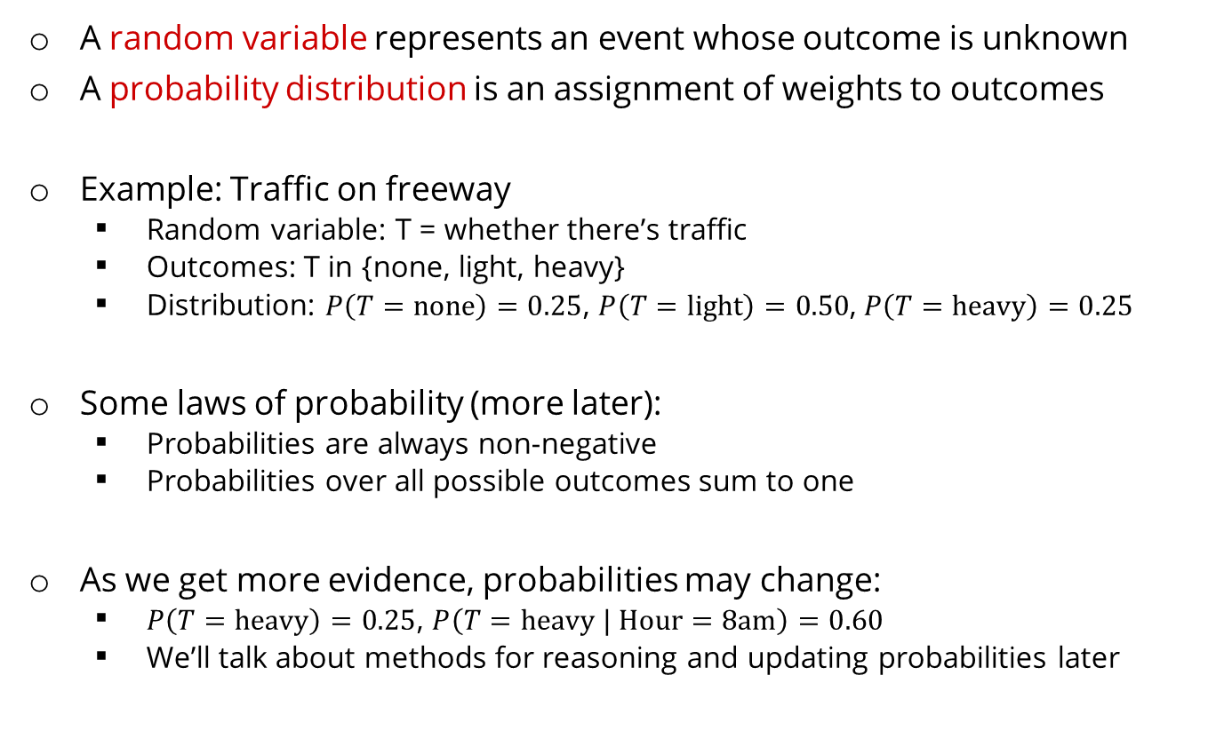
Probabilities
A random variable represents an event whose outcome is unknown
A probability distribution is an assignment of weights to outcomes
Example: Traffic on freeway
Random variable: T = whether there’s traffic
Outcomes: T in {none, light, heavy}
Distribution: $P\left(T=\text{none}\right)=0.25$, $P\left(T=\text{light}\right)=0.50$, $P\left(T=\text{heavy}\right)=0.25$
Some laws of probability (more later):
Probabilities are always non-negative
Probabilities over all possible outcomes sum to one
As we get more evidence, probabilities may change:
$P\left(T=\text{heavy}\right)=0.25$, $P\left(T=\text{heavy} | \text{Hour}=\text{8}\text{am}\right)=0.60$
We’ll talk about methods for reasoning and updating probabilities later
0.25
0.50
0.25
Notes:
In general, we will be computing probabilities. As we get more evidence the probabilities will change. We will look at Probabilistic Inference later in this course.

Slide 144
Probabilities
The expected value of a function of a random variable is the average, weighted by the probability distribution over outcomes
Example: How long to get to the airport?
20 min
30 min
60 min
Time:
35 min
x
+
x
+
x
Probability:
0.25
0.50
0.25
Notes:
.

Slide 145
What Probabilities to Use?
In expectimax search, we have a probabilistic model of how the opponent (or environment) will behave in any state
Model could be a simple uniform distribution (roll a die)
Model could be sophisticated and require a great deal of computation
We have a chance node for any outcome out of our control: opponent or environment
The model might say that adversarial actions are likely!
For now, assume each chance node magically comes along with probabilities that specify the distribution over its outcomes
Having a probabilistic belief about another agent’s action does not mean that the agent is flipping any coins!
Notes:
Where do the probabilities come from? For today, they come from the probability fairy. They are given by the problem definition. Later we will look at how to compute them.

Slide 146
What Probabilities to Use?
Objectivist / frequentist answer:
Averages over repeated experiments
E.g. empirically estimating P(rain) from historical observation
Assertion about how future experiments will go (in the limit)
New evidence changes the reference class
Makes one think of inherently random events, like rolling dice
Subjectivist / Bayesian answer:
Degrees of belief about unobserved variables
E.g. an agent’s belief that it’s raining, given the temperature
E.g. agent’s belief how an opponent will behave, given the state
Often learn probabilities from past experiences (more later)
New evidence updates beliefs (more later)
Notes:
The distinction between frequentist (often termed "objectivist") and Bayesian (often termed "subjectivist") interpretations of probability is a fundamental topic in statistics and machine learning.
### 1. **Definitions and Philosophical Underpinnings**:
- **Frequentist (Objectivist) Probability**:
- Definition: The probability of an event is the long-run frequency of that event occurring after many trials.
- Philosophy: There's an objective reality. Given a repeatable random experiment, probabilities are associated with potential long-run frequencies of outcomes. For example, when we say a fair coin has a 0.5 probability of landing heads, we mean that in many repeated trials, the coin will land heads about half the time.
- **Bayesian (Subjectivist) Probability**:
- Definition: The probability of an event represents a degree of belief or subjective certainty about the occurrence of that event, based on prior knowledge and current evidence.
- Philosophy: Probabilities represent subjective degrees of belief and can be updated as new evidence emerges. These beliefs can vary between individuals, given different prior knowledge or beliefs. Using Bayes' theorem, we can update our beliefs based on new data.
### 2. **Use in Inference**:
- **Frequentist**:
- Estimates parameters by methods such as Maximum Likelihood Estimation (MLE).
- Constructs confidence intervals to describe uncertainty.
- Hypothesis testing is often used to determine if an effect or difference is statistically significant.
- **Bayesian**:
- Uses prior distributions to represent uncertainty about parameters.
- Updates the prior with data to get the posterior distribution.
- Estimates can be point estimates (e.g., the mean of the posterior) or full distributions.
- Credible intervals (analogous to confidence intervals) can be extracted from the posterior distribution.
### 3. **Data & Evidence**:
- **Frequentist**:
- Only the observed data is considered when making inferences.
- Every set of data has one true set of parameter values.
- **Bayesian**:
- Incorporates prior beliefs or knowledge (the prior) and observed data.
- Our beliefs about parameter values are updated as new data becomes available, leading to a posterior distribution.
### 4. **Advantages & Limitations**:
- **Frequentist**:
- **Advantages**: Results are easier to communicate to a general audience. No need to specify a prior.
- **Limitations**: Point estimates don’t always convey uncertainty well. P-values and confidence intervals can be misunderstood.
- **Bayesian**:
- **Advantages**: Provides a more comprehensive view of uncertainty. Can incorporate prior information. Often more flexible, especially in complex models.
- **Limitations**: The choice of prior can be subjective and influence results. Computational complexity can be high for certain models.
### 5. **Classic Analogy: Coin Toss**:
Imagine you've never seen a coin before and you're trying to estimate the probability \( p \) of it landing heads:
- **Frequentist**: You'd flip the coin multiple times and base \( p \) on the proportion of times it landed heads. If you flipped it 100 times and got 55 heads, \( p \) would be 0.55.
- **Bayesian**: You'd start with a prior belief about \( p \) (maybe you think all outcomes are equally likely, so \( p = 0.5 \)). After seeing the coin flipped 100 times and landing heads 55 times, you'd update your belief about \( p \) based on the data and your prior, likely arriving at a value close to (but not necessarily exactly) 0.55.
This is a simplification, but it captures the essence of how each approach views probability and evidence.

Slide 147
Quiz: Informed Probabilities
Let’s say you know that your opponent is running a depth 2 minimax, using the result 80% of the time, and moving randomly otherwise
Question: What tree search should you use?
Answer: Expectimax!
To figure out EACH chance node’s probabilities, you must run a simulation of your opponent
This kind of thing gets very slow very quickly
Even worse if you must simulate your opponent simulating you…
… except for minimax, which has the nice property that it all collapses into one game tree
0.2 0.8
Notes:
…Except, what if your opponent simulates you? You can get into this crazy recursive trees. If you go too far down the computation then
That only really works out for minimax.

Slide 148
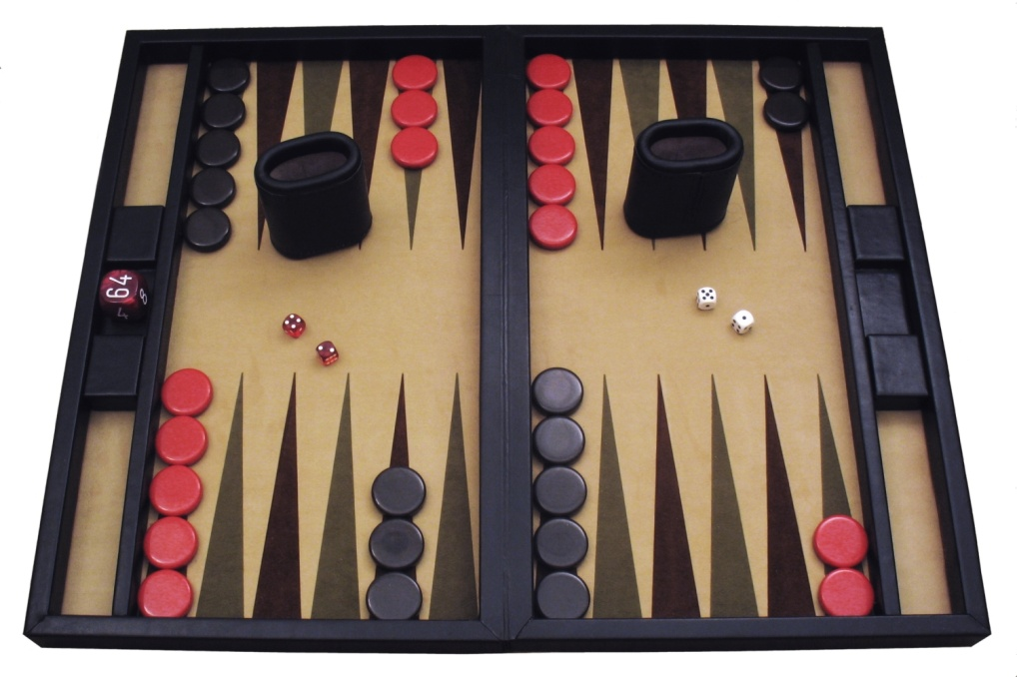
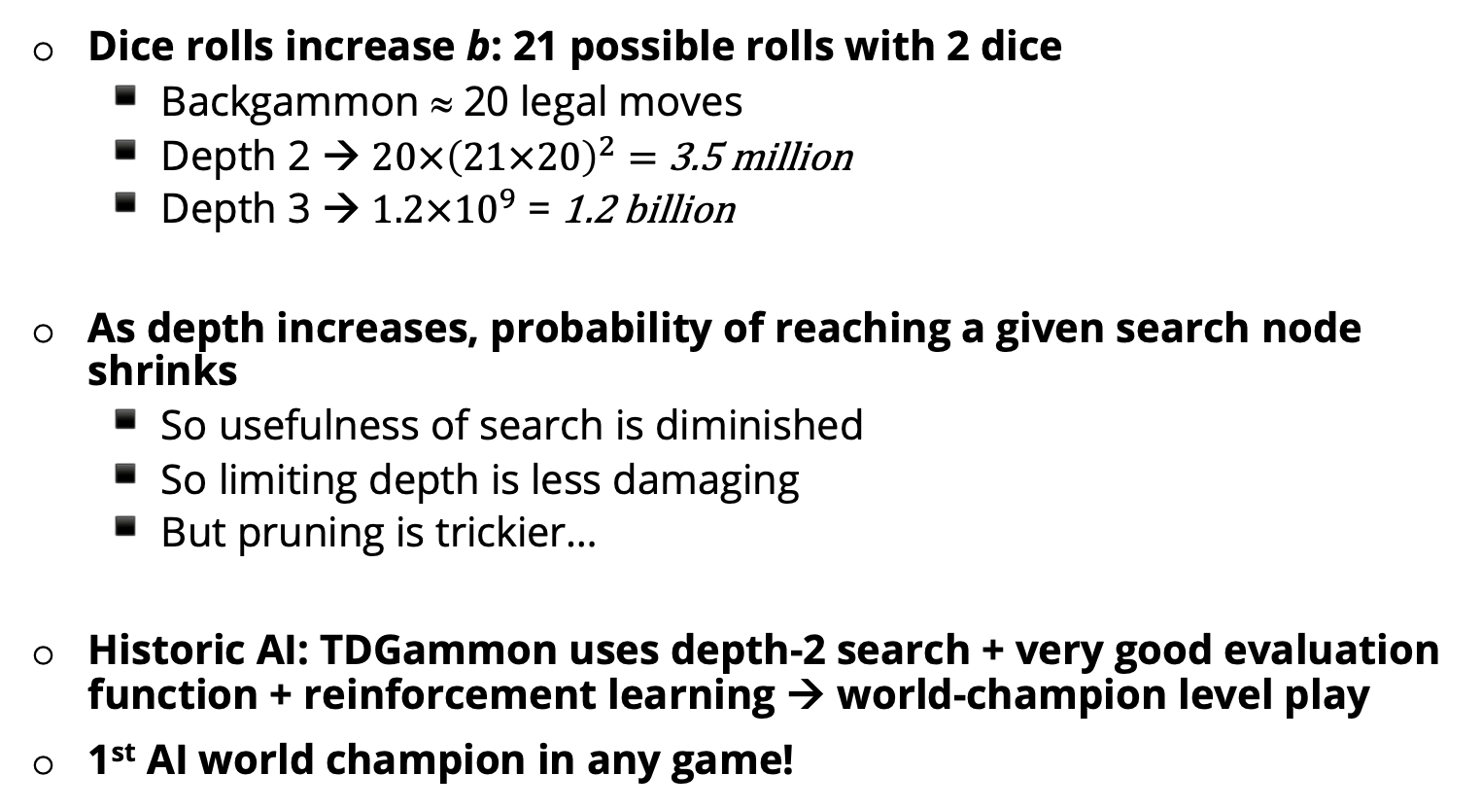
Dice rolls increase b: 21 possible rolls with 2 dice
Backgammon ≈ 20 legal moves
Depth 2 → $20×{\left(21×20\right)}^{2}=$ 3.5 million
$\text{Depth}\text{ 3 → }1.2×{10}^{9}$ = 1.2 billion
As depth increases, probability of reaching a given search node shrinks
So usefulness of search is diminished
So limiting depth is less damaging
But pruning is trickier…
Historic AI: TDGammon uses depth-2 search + very good evaluation function + reinforcement learning → world-champion level play
1st AI world champion in any game!
Notes:
One billion two hundred million states at depth 2.
TD-Gammon is a computer backgammon program developed in 1992 by Gerald Tesauro at IBM's Thomas J. Watson Research Center. Its name comes from the fact that it is an artificial neural net trained by a form of temporal-difference learning,

Slide 149
E.g. Backgammon
Expectiminimax
Environment is an extra “random agent” player that moves after each min/max agent
Each node computes the appropriate combination of its children
Max nodes
Chance nodes
Min nodes
Notes:
I move, you move. Each tie, we roll some dice. This is an expectimenimax tree.
If it’s terminal or we reached our depth limit, return utility.
If you're familiar with Minimax and Expectimax, then understanding Expectiminimax will be straightforward. Let's start by recapping Minimax and Expectimax briefly:
1. **Minimax**:
This algorithm is used for decision-making in two-player games like chess or tic-tac-toe. It assumes perfect play by both players. The algorithm alternates layers: one player is trying to maximize the score (Max) while the other is trying to minimize it (Min).
2. **Expectimax**:
Expectimax is designed for games that involve chance, like card games or dice games. Instead of only having max and min layers, we introduce a chance layer. In the chance layer, we don't pick the best or worst outcome but rather take the expected outcome based on the probabilities of all possible events.
Now, onto **Expectiminimax**:
Expectiminimax combines both of the above concepts. It's used for games that involve multiple players (with conflicting objectives) and chance events.
The algorithm proceeds by expanding a game tree in a way similar to Minimax, but it has three types of nodes:
- **Max nodes**: Representing the decisions of the maximizing player.
- **Min nodes**: Representing the decisions of the minimizing player.
- **Chance nodes**: Representing random events or chance outcomes.
The goal of the maximizing player remains to maximize the score, while the minimizing player tries to minimize it. For the chance nodes, you calculate the expected value based on the probabilities of each branch.
**Process**:
1. For Max nodes: Choose the child node with the maximum value.
2. For Min nodes: Choose the child node with the minimum value.
3. For Chance nodes: Compute the expected value, which is the sum of the children's values weighted by their probabilities.
Expectiminimax is ideal for games like Backgammon, where you have two players trying to win (Max and Min), but there's also the element of chance involved due to dice rolls. In such a game tree:
- Decision nodes for each player will use Minimax logic.
- Dice roll outcomes will be treated as chance nodes and will use Expectimax logic.
This algorithm can be computationally expensive, especially for deep trees or games with many possible chance outcomes. In practice, some form of pruning or approximation methods might be employed to make it tractable.

